Slide 1
NMOSE’s Update: Data Sharing of Completed, Current, & Planned Projects New Mexico Water Data Initiative Directing Agencies Work Group Julie Valdez NM Office of the State Engineer
August 12, 2020

Slide 2
Brief overview
Completed Projects
Current/Ongoing Projects
Planned Projects

Slide 3
Data Sharing of Completed Projects
Public Water Supply Geo-Database
Service Area Boundaries
Albuquerque Metropolitan area
Doña Ana County
All systems that divert > 300 acre-feet/year
Supply Source Location
Budget
~ $89,000

Slide 4
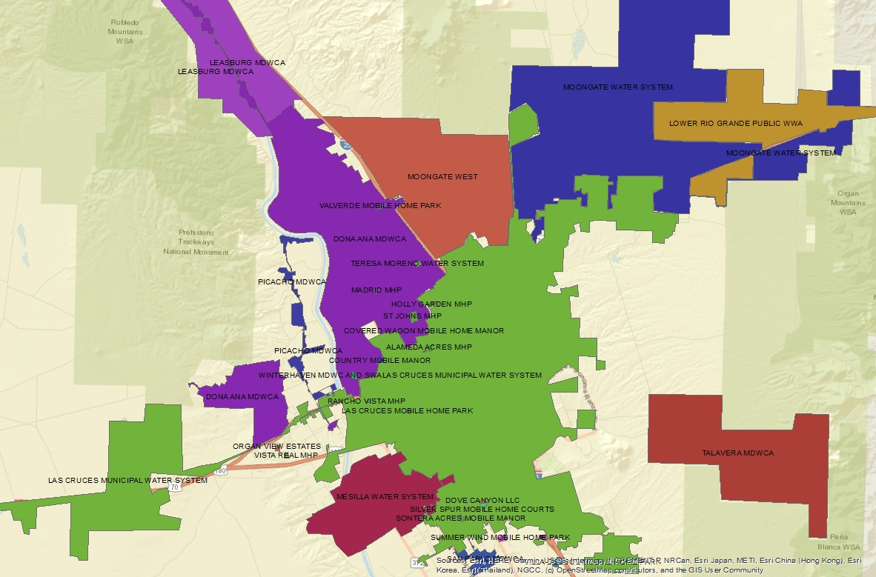
PWS Service Area Boundaries in Doña Ana County

Slide 5
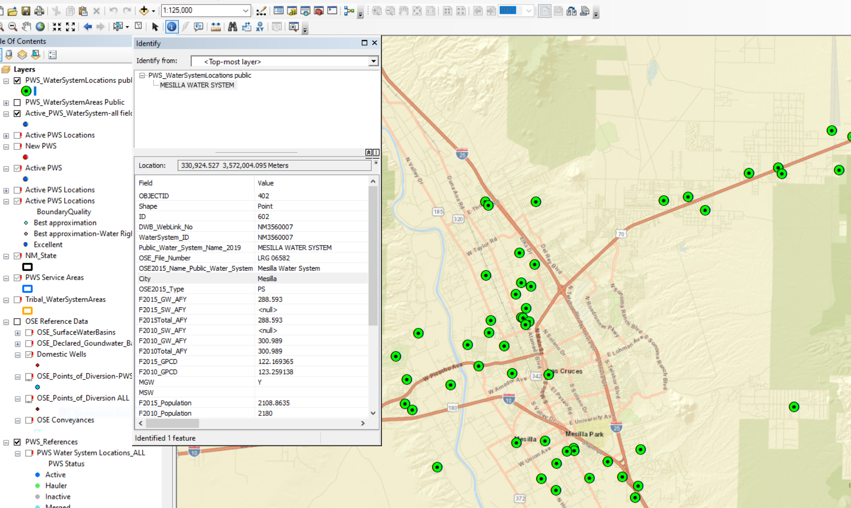
PWS Supply SourceLocation in Doña Ana County

Slide 6
Data Sharing of Current Projects
Acequia Conveyance Layer Data Enrichment
% grade & flow direction
NHD & NM Statewide LiDAR
Geometric network
Budget
~ $11,500
Available on the NM OSE Open Data Site
OSE_Conveyances https://www.arcgis.com/home/webmap/viewer.html?useExisting=1&layers=37977c7ab51c414aa85e74992a2e647e

Slide 7
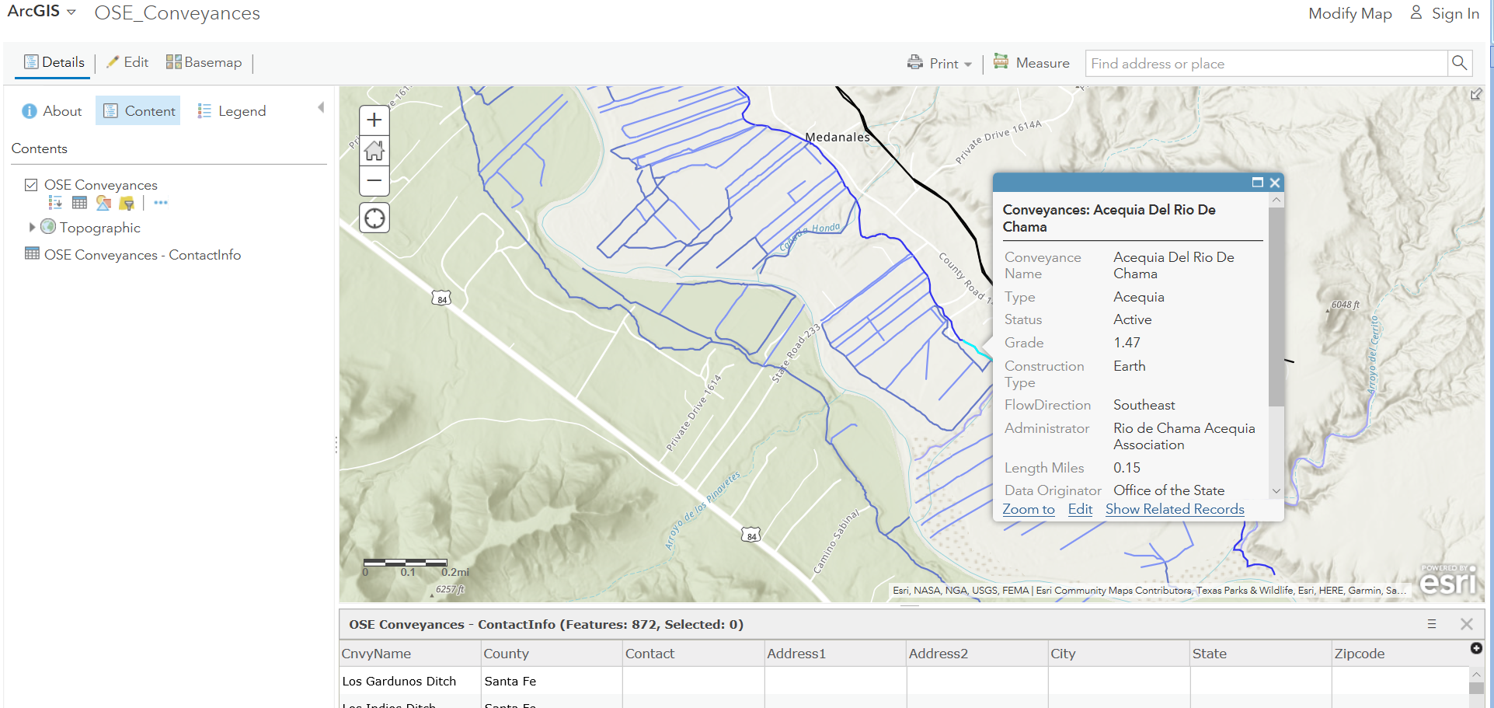

Slide 8
Data Sharing of Current/Ongoing Projects continued
Water Use Case Study
Public Water Supply Category
diversion data WATERS

Slide 9
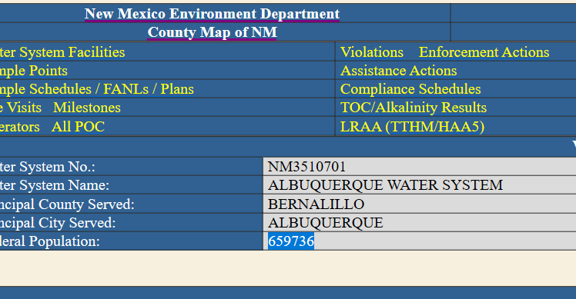
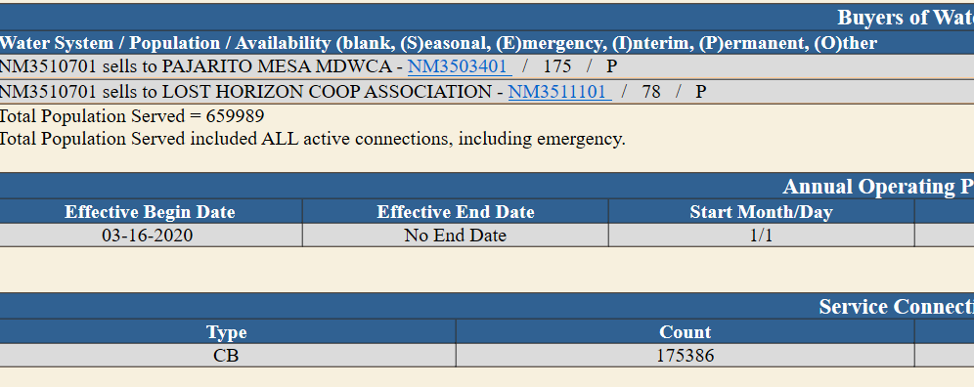
Data Sharing of Current/Ongoing Projects continued
Use Case Study continued
population data NMED

Slide 10
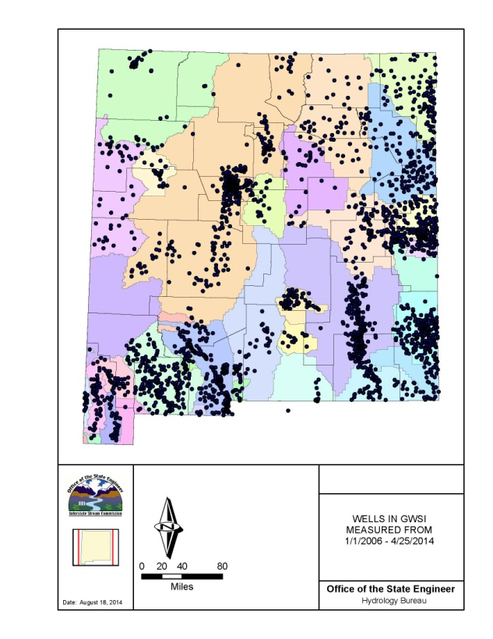
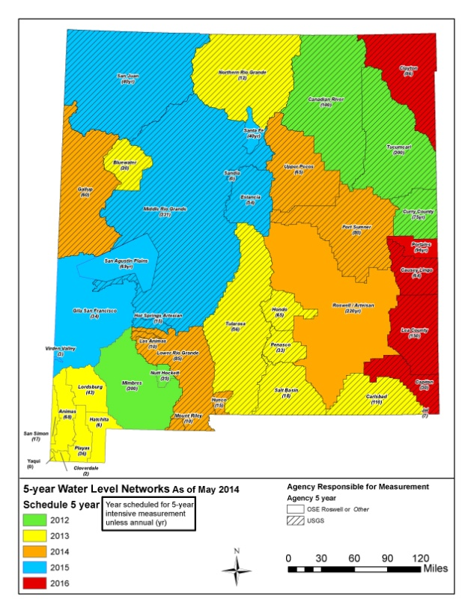
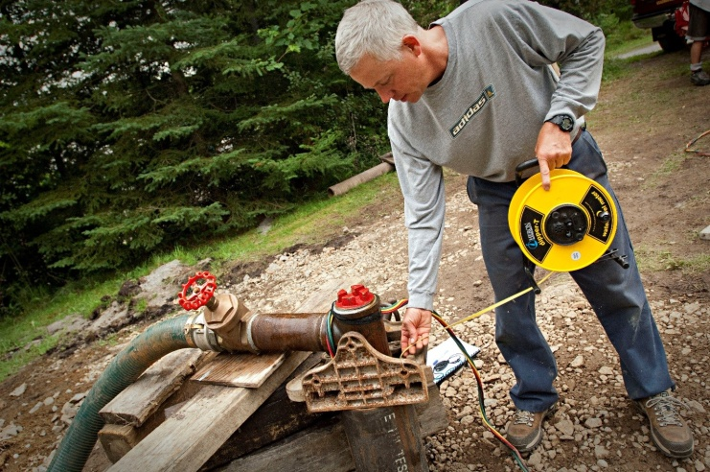
Data Sharing of Current/Ongoing Projects continued
Statewide Groundwater Level Monitoring
Semi-annual water-level measurements
Five-year water level measurements

Slide 11
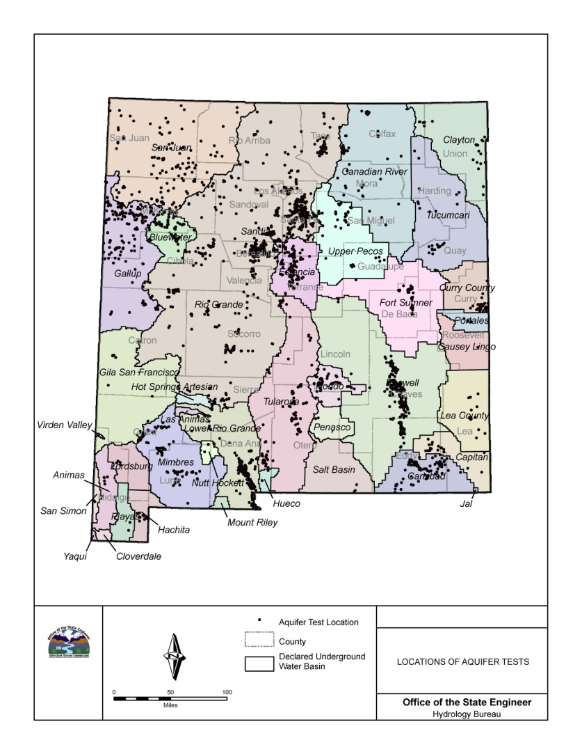
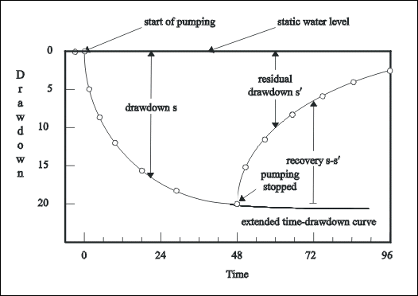
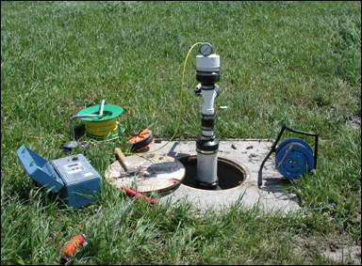
Data Sharing of Current/Ongoing Projects continued
Aquifer Testing
Transmissivity
Storage Coefficients
Over 3,200 test index
https://www.ose.state.nm.us/Hydrology/aquifer.php

Slide 12
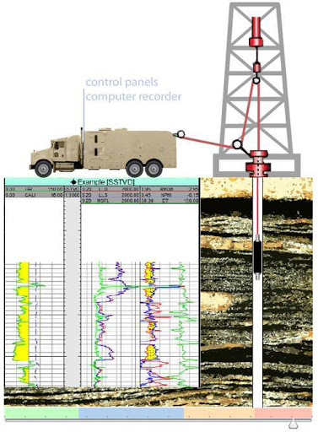
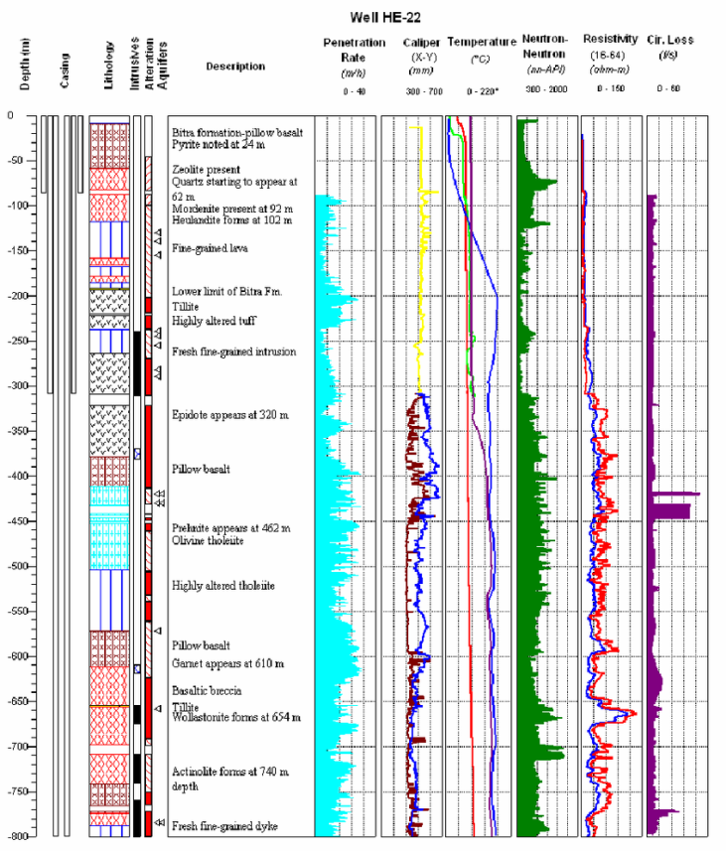
Data Sharing of Planned Projects
Geophysical Well logs
Develop database for larger water well projects

Slide 13
Thank You

