Slide 1
Agenda
9:00-9:45 am WDI Update
Welcome comments
Review of goals from April report (Stacy Timmons)
Progress and plans
Stacy Timmons - Introductions - IT support team (Goal 1)
Jeri Sullivan Graham - New Website and WaterSMART grant (Goal 1 & 4)
Jake Ross - Review System Architecture (Goal 2)
Thushara Gunda - TWG data standards effort (Goal 3)
Emily Geery - Continued stakeholder engagement plans (Goal 4)
9:45-11:00 am: Agency presentations and updates related to any water data projects completed, current, or planned
9:45am: Interstate Stream Commission - Lucia Sanchez, Water Planning Program Manager
10am: Office of State Engineer - Julie Valdez, Water Use and Conservation + others?
10:15am: New Mexico Environment Department - Mary Montoya, CIO and Todd Hochman, IT lead
10:30am: Internet of Water - Kyle Onda - Connections to federal water data
11:00-11:15 am: Break
11:15-12:00 pm: Presentation and discussion on some ideas / plans for data access and use in coming year

Slide 2
Later in the meeting
We will go around the screen listing of participants to give each person about 3 min to speak.
Please plan to reflect on:
A few topics from today that you’d like to learn more about
Questions, data, or ideas to provide to presenters
What we are missing and how can we connect with it?

Slide 3
Directing Agencies Update
August 12, 2020
Stacy Timmons
Associate Director, Hydrogeology Programs
NM Bureau of Geology and Mineral Resources

Slide 4
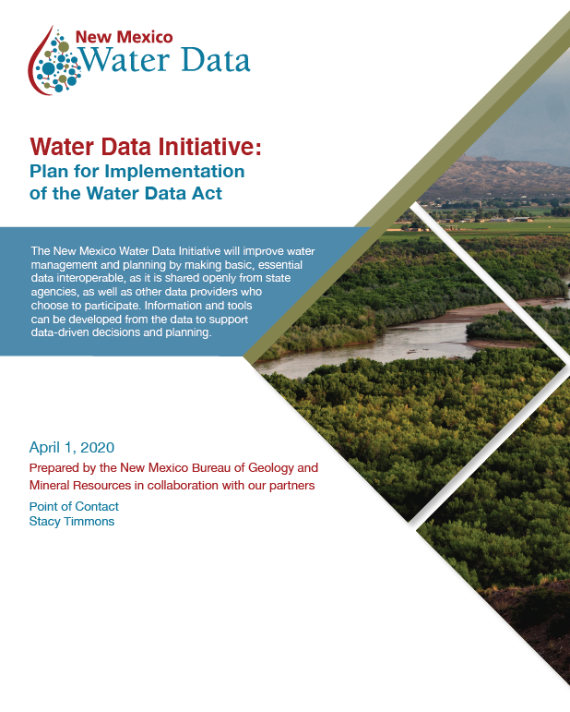
April 2020 Plan
According to legislation – the agencies shall develop and submit a plan to the governor and appropriate interim legislative committees that details:
Assessment of data needed to support water management and planning
Goals, targets, actions in upcoming FY
Budgetary resources needed
Metrics for achieving purpose of the WDA
Includes appendix of materials and budget needs from agencies
https://newmexicowaterdata.org

Slide 5
Goal 1: provide IT support to improve data sharing
Actions
Maintain online water data services
Develop contract services to build IT support
Provide updates, as needed
Metrics
Set up real-time (API) connection of one dataset per agency to WDI
Hire help for data integration and site hosting
Build funding (proposals and awards) in FY 21

Slide 6
Goal 2: Develop Robust IT and data infrastructure plan
Actions
Engage stakeholders – IT leaders in agencies to review needs
Build and leverage partnerships to explore options used in other states
Provide a draft IT infrastructure plan
Obtain peer review of plan
Metrics
Provide draft IT infrastructure plan for review by June 2021
Highlight next steps and gaps (staffing, software, or IT) to accomplish plan – due September 2021

Slide 7
Goal 3: Refine data standards
Actions
Research and evaluate data infrastructure plan
Create summary list of data standards for review
Engage stakeholders: IT support team and TWG – outline needs and data standards
Leverage partnerships to research options in other regions, states or national efforts
Metrics
First draft water data standards for review by June 2021

Slide 8
Goal 4: Continue stakeholder engagement opportunities
Actions
Create an “executive steering committee” with key technical and agency leaders to build agency support and set priorities for WDI
Provide a workshop, training, and/or outreach event for data providers and data users in NM
Establish periodic emails and webinars for data providers on topics of interest
Metrics
At least one workshop, training or outreach event in FY21
Maintain website – keep operational and current

Slide 9
Get Involved
Talk with your teams and agency leaders about NM WDI and ways you’re involved (or want to be involved)
We can provided presentations or materials, as needed – just ask!
Let us know if there are challenges/ blockers for you
Work with us on small group data interviews
Initial time commitment to get acquainted with data
Build sustainable, automated data connections

Slide 10
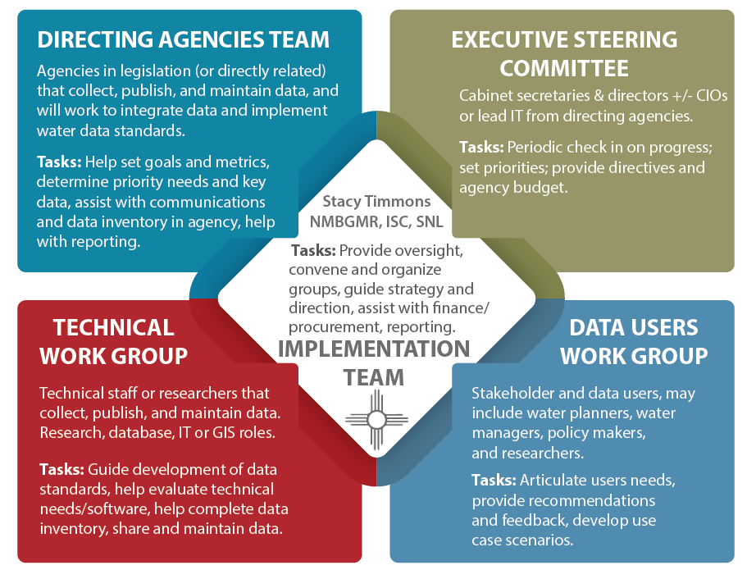
Jeri Sullivan Graham
Stacy Timmons
Thushara Gunda
Emily Geery

Slide 11
Information technology Support Team
Jake Ross (NMBGMR): Technical lead - infrastructure design / testing; help select contract services for specific roles
Andrew Padilla (Datacequia): IT Team lead - help orchestrate agencies IT people / needs for vision; help select contract services for specific roles
Kyle Onda (IOW): Support / review /national ideas
Jeanine McGann (NMBGMR): database support, testing, CKAN / data host support
Brian Keller and Su Zhang (EDAC): CKAN / data host support / interactive maps
Chip Cooper: Web design (WordPress)

Slide 12
Directing Agencies Update
August 12, 2020
Jeri Sullivan Graham
Water Data Specialist

Slide 13
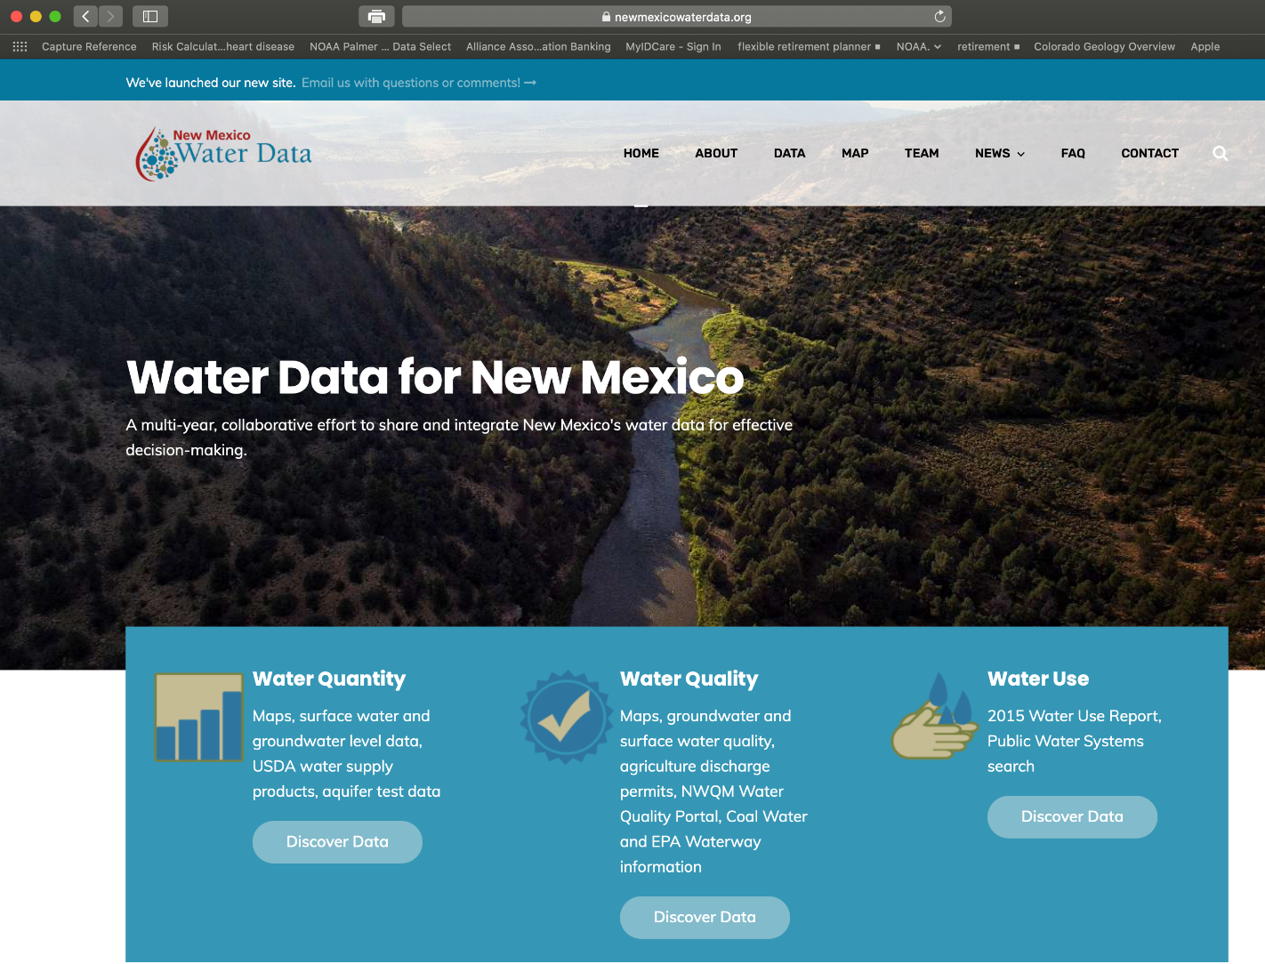

Slide 14
Website launch!
We launched our new website in late July.
https://newmexicowaterdata.org
Site offers a rich view of data, background, project achievements, news, and information related to water data and to FAIR and Open Data dissemination.
Continues links to the CKAN data inventory hosted by EDAC @ UNM
We invite you to test it out. Let us know if you cannot find what you are looking for!
Please send us your information, news, events, and data for inclusion.

Slide 15
Bureau of Rec – Pecos Project Award
BoR WaterSMART proposal call in 2019
Awarded early summer 2020– contract negotiations just finalized
$300k matched by State funding in-house at the Bureau – 3-year project
WaterSMART program aims to “improve access to and use of water resources data” for improved management and decision making.
The Pecos project within the WDI will: support development and implementation of a pilot project for improving management of local ground water and surface water data in the lower Pecos Valley.
The pilot will then become a model for regional data integration and tool development for other regions of New Mexico

Slide 16
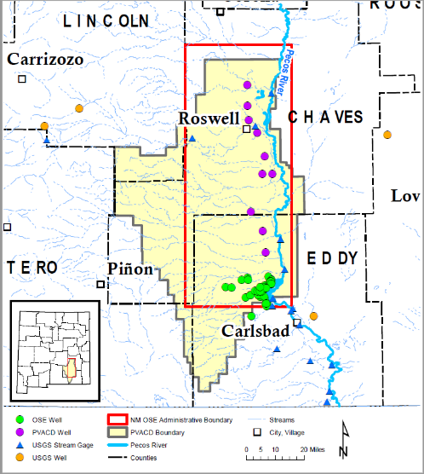
Partners and Next Steps
Partners: Pecos Valley Artesian Conservation District; NM OSE; NM ISC; Internet of Water (Duke University), EDAC
Year 1: Data Discovery and Consensus Building. Understanding local and regional priorities, needs, and challenges; Develop project management plans
Year 2: Implement improved data collection tools and data management solutions. Align with FAIR data principles.
Year 3: Fine-tune workflow of data collection, ingestion, and management. Improve decision support tools and data visualization; disseminate results and lessons learned.

Slide 17
WDI System architecture
Jake Ross, NMBGMR, presenter

Slide 18
Technical Working Group Update
August 12, 2020
Thushara Gunda, Sandia National Laboratories
Technical Working Group Lead

Slide 19
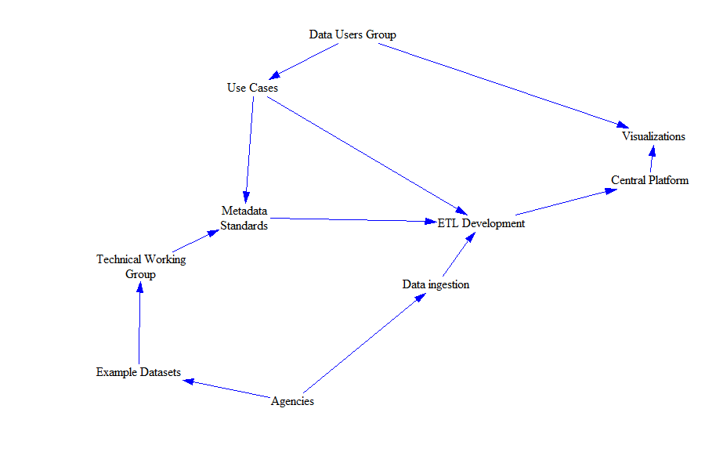
Who are we? What do we do?
Technical staff or researchers that collect, publish, and maintain data. Our roles range from research, database, IT, to GIS.
Guide development of data standards, help evaluate technical needs/software, and assist with completion of data inventory.
Activities influenced by the needs of the software developers working group and the data users working group.
Replace figure with updated version

Slide 20
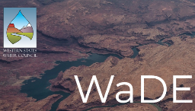
How do we do it?
Leverage existing resources & standards
Discuss needs with the user groups and data owners
Document common understanding of NM-relevant datasets following FAIR practices
→Reference for database design activities
→Educational resource for local entities
Notes:
Our intent is not to create new standards but rather develop common understanding of minimum data fields required to facilitate the findability, accessibility, interoperability, and reusability of NM water data.

Slide 21
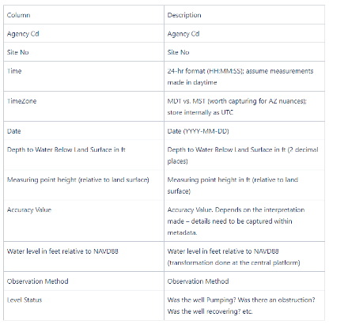
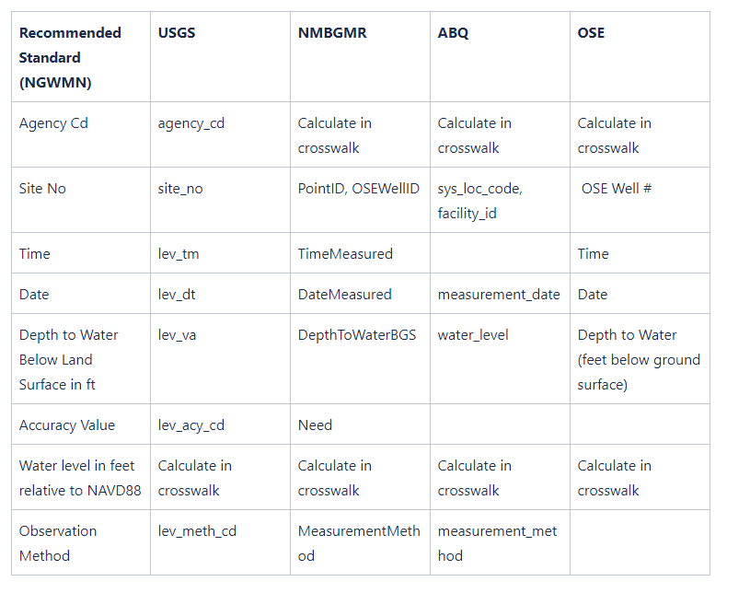
Progress to Date
Collated existing standards
Geospatial
Quantity
Quality
Developed standards
Metadata for wells
Groundwater levels (example of right)
Many others in progress
Minimum Elements
Crosswalk

Slide 22
Data Users Work Group Update
Aug 12, 2020
Emily Geery
Data Users Work Group Lead

Slide 23
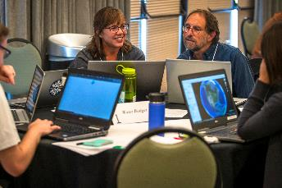
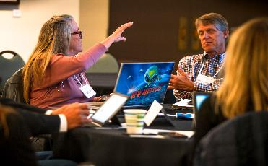
Stakeholder Engagement
Who?
Stakeholders and data users, may include water planners water managers, policy makers, and researchers
What do we do?
Tasks: Articulate users needs, provide recommendations and feedback, develop use case scenarios

Slide 24
Providing Information to Meet Your Needs
High-level Needs (January Survey)
Workshops
Transferring data
Responsibility
Coordination / planning/ communication
Improve existing data systems
Initiate new data projects
Improve quality of data
IT support available at workshops
Tool development workshop
Small group tutorial
Communication
Use cases
Target Audience: Directing agencies
Format: Online workshop
Length of Time: 1 hour

Slide 25
Workshops
Workshop 1: Tool Development
Workshop 2: Making it Work
Goal: Identify tools needed
Engage in a data problem-solving exercise
What tools do you need and why?
Goal: Learn how your datasets can be uploaded to the Data Service
Small group + IT Support Team
Work with your datasets
Ask me anything

Slide 26
Workshops (continued)
Workshop 3: Data Stories Videos
Workshop 4: Use Cases
Goal: Discuss why data stories matter
2 Data Stories completed
Components of data stories
Q&A with producer
Identify new data stories
Goal: Present findings from 1st use case
What is a use case?
Lessons learned
Ideas for new use cases

Slide 27
Agenda
9:00-9:45 am WDI Update
Welcome comments
Review of goals from April report (Stacy Timmons)
Progress and plans
Stacy Timmons - Introductions - IT support team (Goal 1)
Jeri Sullivan Graham - New Website and WaterSMART grant (Goal 1 & 4)
Jake Ross - Review System Architecture (Goal 2)
Thushara Gunda - TWG data standards effort (Goal 3)
Emily Geery - Continued stakeholder engagement plans (Goal 4)
9:45-11:00 am: Agency presentations and updates related to any water data projects completed, current, or planned
9:45am: Interstate Stream Commission - Lucia Sanchez, Water Planning Program Manager
10am: Office of State Engineer - Julie Valdez, Water Use and Conservation + others?
10:15am: New Mexico Environment Department - Mary Montoya, CIO and Todd Hochman, IT lead
10:30am: Internet of Water - Kyle Onda - Connections to federal water data
11:00-11:15 am: Break
11:15-12:00 pm: Presentation and discussion on some ideas / plans for data access and use in coming year

Slide 28
Directing Agencies Meeting
ISC’s WATER DATA ACT PARTICIPATION
LUCIA SANCHEZ
WATER PLANNING PROGRAM MANAGER,
INTERSTATE STREAM COMMISSION
DIRECTING AGENCIES MEETING
AUGUST 12, 2020

Slide 29
WATER PLANNING PROGRAM & WATER DATA ACT
HOT TOPICS IN WATER PLANNING
FY20 SUPPORT
$62,000 in contractual & technical support
ISC Program Management
Engagement
Water Data
Education & Outreach
Climate & Drought

Slide 30
ENGAGEMENT / COORDINATION
FY 21 PRIORITIES
2019 HB 651 Water Data Act
2019 HB 266 Forest And Watershed Advisory Board
State Water Planning/50-year Water Plan Conceptualization
Water and Climate Expert Advisory Committee
Governor’s Climate Change Task Force
Rio Grande Basin Study
Drought Task Force
Education and Outreach
15

Slide 31
NM Office of the State Engineer
Julie Valdez, Water Use & Conservation

Slide 32
NM Environment Department
Mary Montoya, CIO & Todd Hochman, IT lead

Slide 33
Internet of Water
Kyle Onda, Data Architect

Slide 34
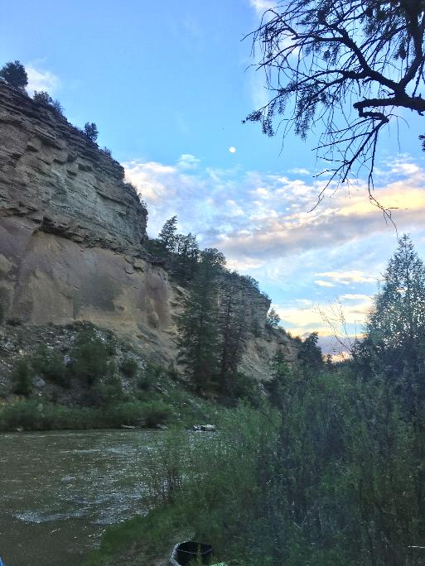
ENERGY MINERALS and Natural resources
Kevin Myers, EMNRD

Slide 35
Break Till 11:15

Slide 36
Big Questions
By setting up a few big questions to answer, it can help focus our efforts and prioritize datasets.
How much water is being used in New Mexico? (category of water use, volume, rate, source)
Where does my water come from? Is it safe to drink?
Where are we monitoring water in New Mexico?

Slide 37
Provide Quick Access
http://www.twdb.texas.gov/flood/prep/

Slide 38
1. How much water IS BEING USED?
Potential datasets:
OSE - Points of Diversion
Real time diversion data – OSE and USGS
Tax and Revenue or County Assessors- cattle head count (used to estimate livestock water use)
Reservoir water levels - ET estimation (ISC)
ET data - various models and raw data
Ag water use - e.g. metered data from EBID, PVACD; estimated from Blaney Criddle ET methods
OCD - produced water volumes vs injected
Locally provided data sources (i.e. larger public water suppliers, irrigation districts)
Potential use cases:
Map of GPCD for all public water systems
Links to datasets through WDI – to improve Water Use by Category reporting
More dynamic water use visualizations (annual?)
Notes:
In order to carefully plan how much water we can use in the future, and build more dynamic tools to help us prepare in times of water plenty or water shortage, we first need to accurately account for how much is actively being used. This accounting of water use has been inventoried in NM since 1896, and since 1975, a Water Use by Category Report has been produced every 5 years by the Office of the State Engineer. Some aspects of this report can be accomplished more frequently if data are more accessible. This question will also undoubtedly highlight the gaps in some of our monitoring efforts in NM. Views of these data can be sliced and diced in different ways - such as county or watershed, and over select time periods.

Slide 39
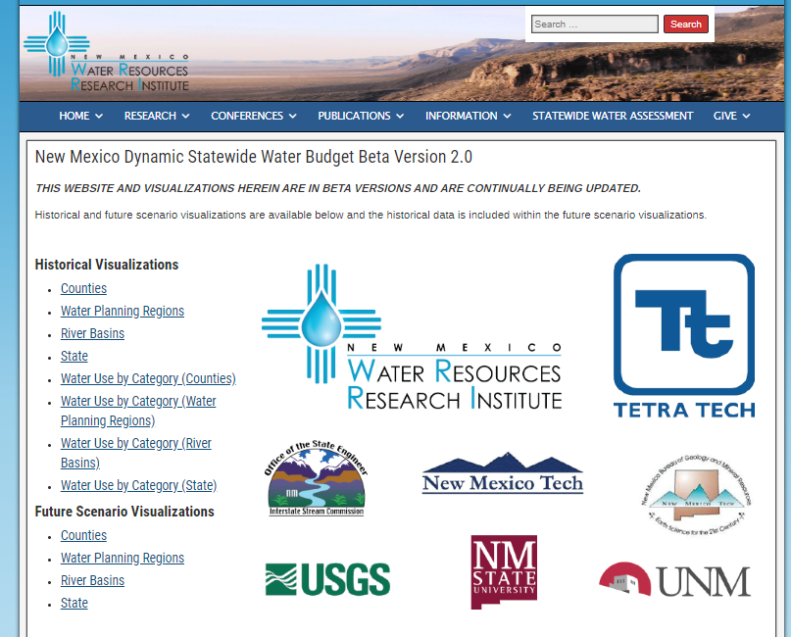
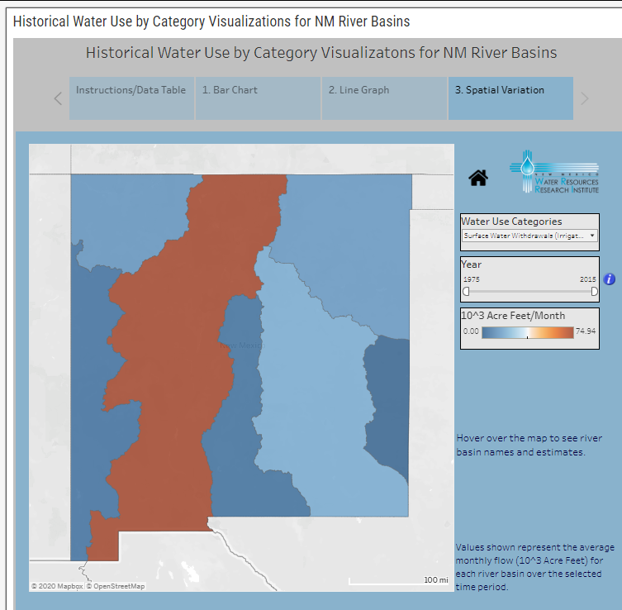
NM WRRI visualizations
https://nmwrri.nmsu.edu/new-mexico-dynamic-statewide-water-budget/

Slide 40
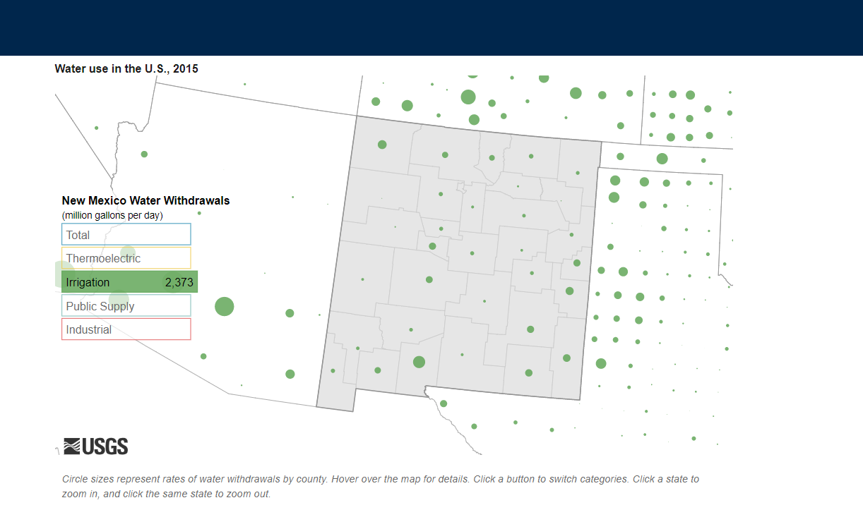
USGS visualization
https://labs.waterdata.usgs.gov/visualizations/water-use-15/

Slide 41
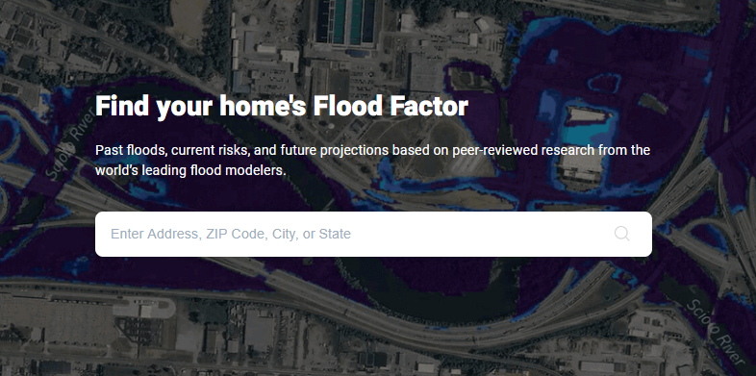
2. Where does my water come from? Is it safe to drink?
Potential datasets:
Public water systems geospatial boundaries
SDWIS data on Public Water Systems
OSE WATERS data on Point of Diversion
Potential use cases:
Public education – map of source of water and any current violations of water quality in that region
Improve data access for Source Water Protection planning
Map of NMRWA “best tasting water” winners
https://floodfactor.com/
Notes:
Many people in NM do not actually know where their water comes from - groundwater, river water, or a blend? Many people on private domestic wells in the state do not realize the need for periodic water testing for possible contaminants. Some locations in our state do not have ready access to safe, reliable drinking water, especially in rural, remote areas. In regions where water is provided from a public drinking water supplier, these waters are regulated by the NMED and US EPA to ensure safe drinking water. When clean drinking water from the tap is available, money can be saved from purchasing expensive bottled water. While not always front and center, water quality is an influential economic driver for NM. Buying and selling property in the state often includes discussions of the quality of the available water for intended purposes, as well as quantity available.

Slide 42
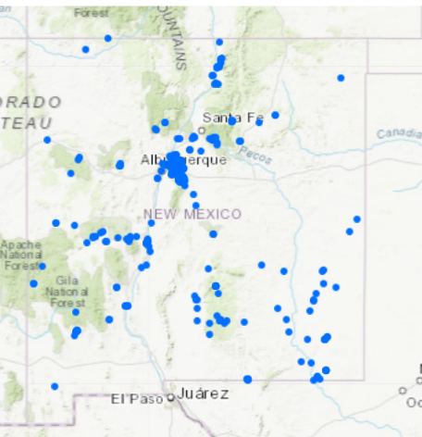
3. Where are we monitoring in NM?
Potential datasets
USGS stream gage data
Real time diversion data - OSE
USGS Groundwater monitoring network + any committed pressure transducers-
NMBGMR groundwater level monitoring network
Reservoir levels (USGS and BOR)
Currently operating precip and meteorological stations (NOAA, CoCoRahs)
Regional data contributors, such as EBID, PVACD, Rio Rancho, East Mountains, etc.
Potential use cases
Data access for all CURRENT groundwater level data
Data gap analysis and prioritization
Map showing current reservoir levels
https://geoinfo.nmt.edu/resources/water/cgmn/home.cfml
Notes:
Monitoring our water resources is important for New Mexico to move forward with more dynamic and responsive water planning. In addition to understanding the uses of water, we also need to know the most current water trends provided with real-time or near-real-time data. Several different groups in the state are involved in collecting this type of data, as well as numerous federal and local networks. Some state funding is used to fund federal agencies to host data, therefore these data should be directly included in the NM WDI. The frequency of data collection is variable, depending on the resource. For example, with groundwater levels changing more slowly than surface water, having an annual measurement may be sufficient for some locations to be considered current. Surface water, on the other hand, varies on a daily basis. With quick access to these datasets, numerous agencies can be more responsive to public questions or concerns about water availability.

Slide 43
Feedback and ideas Welcome
Comments or ideas on these 3 big questions?
How much water is being used in New Mexico? (category of water use, volume, rate, source)
Where does my water come from? Is it safe to drink?
Where are we monitoring water in New Mexico?
Notes:
What are your big questions we can work on with better access to data?
What data are needed to address it?

Slide 44
Discussion Phase
We will go around the screen listing of participants to give each person about 3-5 min to speak.
Please plan to reflect on:
A few topics from today that you’d like to learn more about
Questions, data, or ideas to provide to presenters
What we are missing and how can we connect with it?

