Slide 1
Common Data Standards
Water Data Inventory

Slide 2
Background
Every agency has their own internal practices and standards but we require a common understanding to ensure data is being accurately represented within the central platform
Scope
Leverage existing resources (including waterML, NGWMN, and USGS/National Geospatial Program)
Capture details relevant for NM water data types
Not to create a new standard
Objective:
Create a single document that could serve as a
reference for database design activities and
educational resource for local entities
Notes:
waterML: https://www.ogc.org/standards/waterml
NGP: https://www.usgs.gov/core-science-systems/ngp/ss/product-standards

Slide 3
Data Types
The basic elements of SensorThings are
Location - physical location of the observations as a geoJSON feature. Can be a point or polygon.
Thing - A collection of one or more sensors/an abstract description of what is being measured e.g Water Levels
Sensor - The sensor doing the measurement
Datastream - A group of observations of an observed property by a sensor for a thing at a given location
ObservedProperty - Description of what is being observed
Observations - The actual time vs intensity data
Metadata
Site type
Lat/long
…
Measurements
Date
Levels
Quality
Use
….
Notes:
SensorThings is a service focused on data streaming. Metadata of well itself can be incorporated into SensorThings model or within CKAN.

Slide 4
Process
Reactive – focus on creating standards as new dataset are being ingested into CKAN…
Need to map different columns of collected data
Think about what's the hierarchy of the data, is it stored in normalized or non-normalized formats etc.

Slide 5
Site Metadata
UniqueIDs for wells:
Former Project on UniqueID for every well in the state. EnvDept, OSE, and USGS crosswalks. Gar can send us the reports/excel sheets.
Funding need exists to push this work forward
OSE: Well-tagging program from ~Fall 2018 for new production wells (e.g., domestic, livestock, irrigation, commercial-use wells). Non-production wells are not tagged, e.g., monitoring wells, piezometers, etc. Tags are alpha-numeric and entered into WATERS. Tag is either a barcode or QR code on the tag, but the agency does not have a way to use them yet. The tags are provided for by a Department of Health grant.
DOE has their own unique IDs as well: see web application - https://gems.lm.doe.gov/#site=APC
Base | Description
Agency Code | Agency Name | Agencies that own a well may have a unique code. However, for some agencies the
Site Number | Site Number | Code might represent local codes used by that agency.
Site Name | Site Name
Latitude/Longitude (Geospatial info) | Latitude/Longitude | Based on geographic information - straight forward points
Horizontal Datum | Horizontal Datum | UTM 13N (horizontal: NAD83; vertical: NAVD88)*
Altitude | Altitude
Site Type | Well, Reservoir, etc.
Agency information might be more appropriate within the measurements table (b/c different agencies may measure the same well)
2022 – datum changes forthcoming
*localized distortion on the western parts of the state. Worth making a note about translations might be needed for accuracy.
*Web Mercator is the default for most map services. So need to verify that
Column | Description
Site No | Site No
Well Depth | Well Depth
Aquifer Name/Type | Aquifer Name/Type
Casing (end depth) | Casing (end depth)
Casing (internal diameter) | Casing (internal diameter)
Screening depth (begin – end) | Screening depth (begin – end)
Flow rates | Flow rates
Well Type | Monitoring, Pumping, Injection, etc.
Wells

Slide 6
Crosswalk: Well Metadata
Recommended Standard (NGWMN) | USGS | NMBGMR | ABQ | OSE
Agency Cd | agency_cd | NMBGMR | ABQ | OSE
Site No | site_no | PointID | sys_loc_code
 |  | OSEWellID |  | OSE Well #
Agency Nm | United States Geological Survey | New Mexico Bureau of Geology & Mineral Resources | NEED NAME | Office of State Engineer
Site Name | station_nm | SiteID | loc_name
Dec Lat Va | dec_lat_va | Geometry | latitude | Latitude
Dec Long Va | dec_long_va | Geometry | longitude | Longitude
Horz Datum | dec_coord_datum_cd | Need
Alt Va | alt_va | Altitude | exact_elev | Groundwater Elevation
Alt Datum Cd | alt_datum_cd | Need
Well Depth | well_depth_va | WellDepth | measured_depth_of_well | Total Depth (feet)
Site Type | site_tp_cd | Need

Slide 7
Water Levels
a. streamflow (CFS) instantaneous
b. lake/reservoir levels (Feet),
c. Reservoir volume (acre-feet) accompanied by area-capacity table
d. groundwater levels (Feet, below ground surface)-usually feet below measuring point accompanied by elevation of measuring point and elevation above ground of measuring point-could look at the parameters in USGS NWIS to spell out every last detail
e. Soil moisture (volumetric water content)
f. Precipitation (inches)
g. evapotranspiration (percent of precipitation)
Column | Description
Agency Cd | Agency Cd
Site No | Site No
Time | 24-hr format (HH:MM:SS); assume measurements made in daytime
TimeZone | MDT vs. MST (worth capturing for AZ nuances); store internally as UTC
Date | Date (YYYY-MM-DD)
Depth to Water Below Land Surface in ft | Depth to Water Below Land Surface in ft (2 decimal places)
Measuring point height (relative to land surface) | Measuring point height in ft (relative to land surface)
Accuracy Value | Accuracy Value. Depends on the interpretation made – details need to be captured within metadata.
Water level in feet relative to NAVD88 | Water level in feet relative to NAVD88 (transformation done at the central platform)
Observation Method | Observation Method
Level Status | Was the well Pumping? Was there an obstruction? Was the well recovering? etc.

Slide 8
Crosswalk: Water Levels
Recommended Standard (NGWMN) | USGS | NMBGMR | ABQ | OSE
Agency Cd | agency_cd | Calculate in crosswalk | Calculate in crosswalk | Calculate in crosswalk
Site No | site_no | PointID | sys_loc_code
 |  | OSEWellID | facility_id | OSE Well #
Time | lev_tm | TimeMeasured |  | Time
Date | lev_dt | DateMeasured | measurement_date | Date
Depth to Water Below Land Surface in ft | lev_va | DepthToWaterBGS | water_level | Depth to Water (feet below ground surface)
Accuracy Value | lev_acy_cd | Need
Water level in feet relative to NAVD88 | Calculate in crosswalk | Calculate in crosswalk | Calculate in crosswalk | Calculate in crosswalk
Observation Method | lev_meth_cd | MeasurementMethod | measurement_method

Slide 9
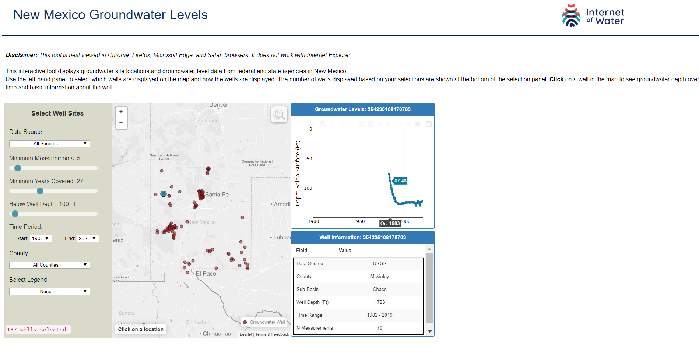
IoW CrossWalk
Visualization: http://people.duke.edu/~lap19/www/nm_groundwater/index.html
Associated code: https://github.com/internetofwater/IS-NM-groundwater/tree/master/nm_groundwater_updated

