Slide 1
NMED Open Data Portal
Libertating data from the silos that constrain it

Slide 2
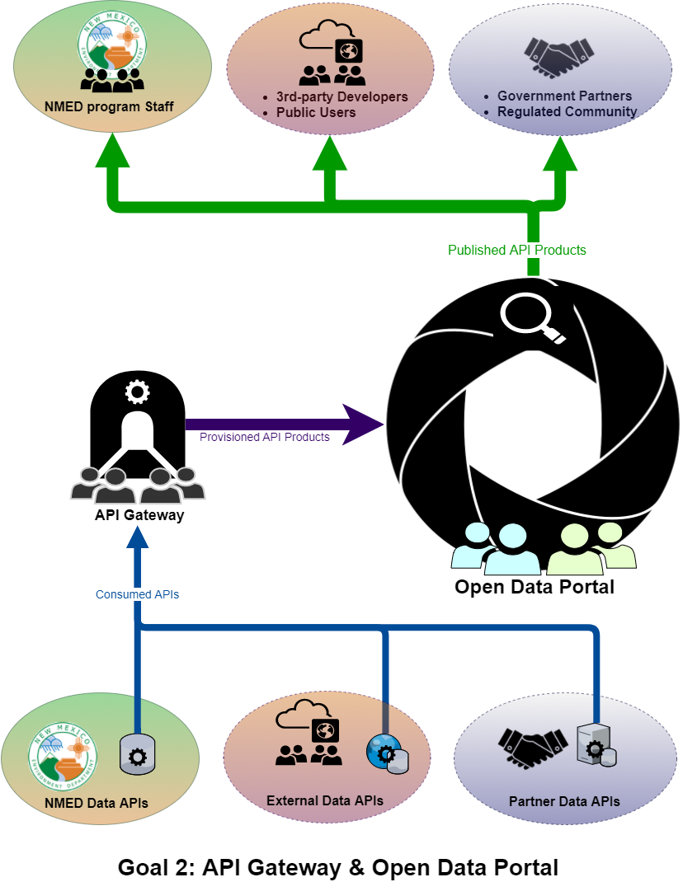
How the Portal Works
APIs are uploaded to the Gateway.
APIs are bundled/packaged as API products and published to the Open Data Portal.
Those APIs are then available for use via the ODP for registered users with the correct access role.

