Slide 1
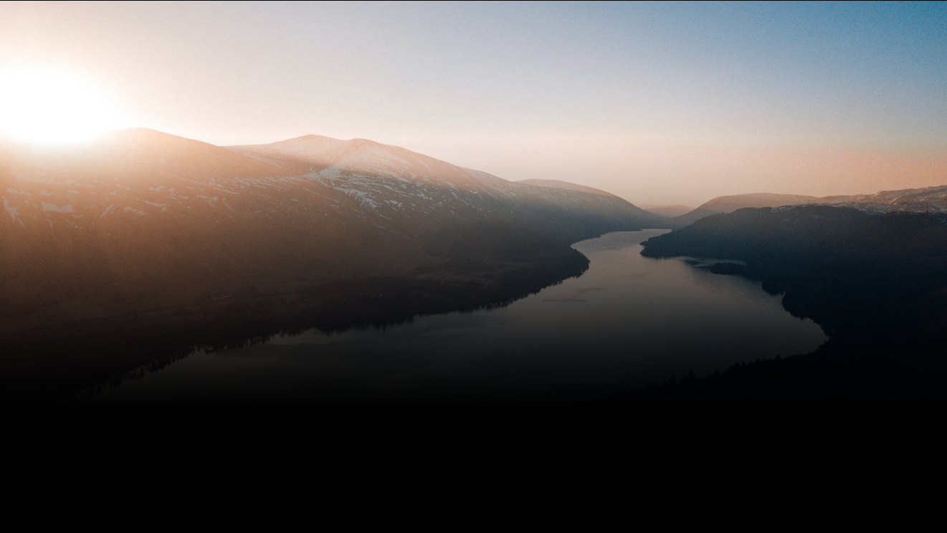
Community Lightening Slides - Kyle
Integrating Federal Data with the NMWDI
NMWDI Directing Agencies Work Group Meeting
August 12, 2020
Kyle Onda: kyle.onda@duke.edu
Notes:
I’m my name is Lauren Patterson and I am going to present on some work that Kyle Onda has been doing with the USGS, to help make water data more findable by making it easier to identify specific datasets, locate those datasets, and link those data to similar datasets that might be of interest.
It turns out this is really a big lift because no one entity holds all the data. Lots of local, state, and federal actors hold different pieces of water data – quantity, quality, surface, ground, brackish, human use, precip, etc.

Slide 2
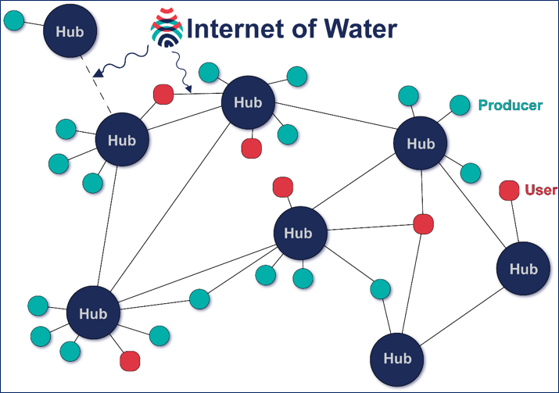
Internet of Water is:
An aspirational concept of linked water data systems
A decentralized, collaborative multi-organization initiative to organize water data on the internet
A project (currently at Duke University) providing key social and technological infrastructure supporting the above
Particular focus on state/local agencies and NGOs
Notes:
The Internet of Water was conceived as a way to make data held by different agencies (the data producers) more findable, accessible, and usable. It was recognized early on that no one entity can hold all the data – not like the IBDm internet movie database. But that each entity holds a different piece of the puzzle… so how do we find data and how do we make data located in a similar area more discoverable, and how do we do this in a thoughtful way and to move as a community towards different types of standards.

Slide 3
How will Federal Data be Integrated with NM Data?
How will Federal data be interacted with through NMWDI services?
How will other Federal data about a given feature in NM be discovered or de-duplicated from NM data about the same and related feature?
Notes:
The Internet of Water was conceived as a way to make data held by different agencies (the data producers) more findable, accessible, and usable. It was recognized early on that no one entity can hold all the data – not like the IBDm internet movie database. But that each entity holds a different piece of the puzzle… so how do we find data and how do we make data located in a similar area more discoverable, and how do we do this in a thoughtful way and to move as a community towards different types of standards.

Slide 4
How will Federal Data be Integrated with NM Data?
How will Federal data be interacted with through NMWDI services?
How will other Federal data about a given feature in NM be discovered or de-duplicated from NM data about the same and related feature?
1: Application Layer (see NMWDI Architecture)
2. Via API proxying (see NMED)
- USGS NWIS
- USBR RISE
- USEPA SDWIS/ ATTAINS/ WQX
- USACE A2W
- NOAA NCDC CDO
Notes:
The Internet of Water was conceived as a way to make data held by different agencies (the data producers) more findable, accessible, and usable. It was recognized early on that no one entity can hold all the data – not like the IBDm internet movie database. But that each entity holds a different piece of the puzzle… so how do we find data and how do we make data located in a similar area more discoverable, and how do we do this in a thoughtful way and to move as a community towards different types of standards.

Slide 5
How will Federal Data be Integrated with NM Data?
How will Federal data be interacted with through NMWDI services?
How will other Federal data about a given feature in NM be discovered or de-duplicated from NM data about the same and related feature?
1: Application Layer (see NMWDI Architecture)
2. Via API proxying (see NMED)
- USGS NWIS
- USBR RISE
- USEPA SDWIS/ ATTAINS/ WQX
- USACE A2W
- NOAA NCDC CDO
Notes:
The Internet of Water was conceived as a way to make data held by different agencies (the data producers) more findable, accessible, and usable. It was recognized early on that no one entity can hold all the data – not like the IBDm internet movie database. But that each entity holds a different piece of the puzzle… so how do we find data and how do we make data located in a similar area more discoverable, and how do we do this in a thoughtful way and to move as a community towards different types of standards.

Slide 6
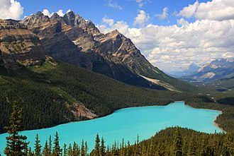
Currently…
I wonder how much water is in my favorite lake to visit?
Favorite Lake water levels
Notes:
Currently, a data user interested in data about some body of water might google that body of water and some data terms. Currently, the top results might be a major data provider like the USGS with some further links to more data.

Slide 7
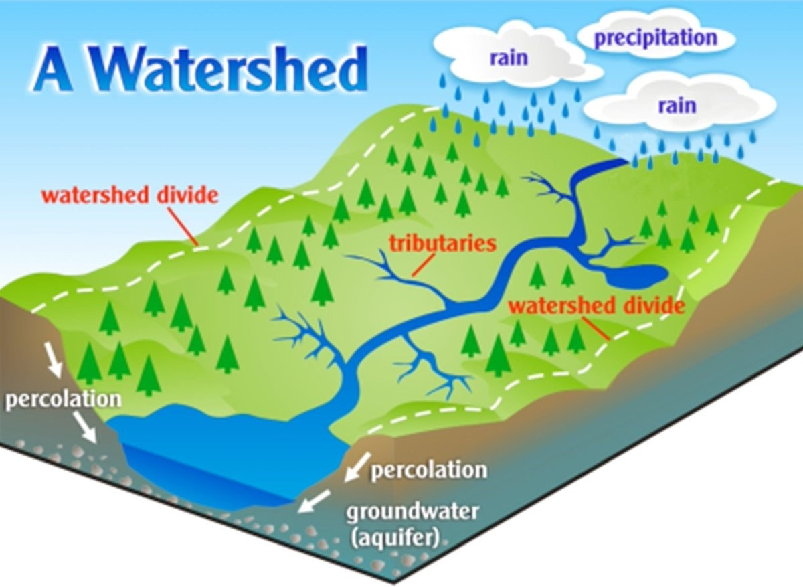
Future Vision
I wonder how much water is in my favorite lake to visit?
Oh, I didn’t know these other data existed… Is it safe to swim or fish…
Favorite Lake water levels
Notes:
Ideally, when someone searches such a thing, she should be directed to not just one organization’s data about that body of water, but all relevant data, including from upstream tributaries and adjacent water systems, from all organizations collecting data in the relevant water systems.
It would explose the data user to other data that might be incredibly relevant and helpful to use for decision-making

Slide 8
CURRENT STATUS
Notes:
How are we going to do this?

Slide 9
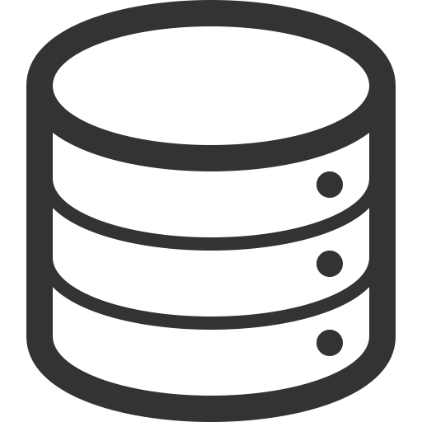
Geoconnex Does 3 Things
sdfsfsdfs
Same ???
(1) Unique IDs – a persistent identifier unique to each dataset
Well #1
Well #1
The water version of a DOI
https://geoconnex.us/epa/hmw/020700110204
Geoconnex
version
of DOI
Registered
organization
name
Organization’s
Unique ID for
Data
+
+
Notes:
(1) Unique ID. Let’s say you are pulling data together from all these different sources and you come across several wells with the same ID. Are they really the same well? With Geoconnex, no ID will be duplicated. Similar to a DOI for journal articles published by different agencies.

Slide 10
Geoconnex Does 3 Things
sdfsfsdfs
Same ???
(1) Unique IDs – a persistent identifier unique to each dataset
Well #1
Well #1
The water version of a DOI
https://geoconnex.us/
https://geoconnex.us/epa/hmw/020700110204
Geoconnex
version
of DOI
Registered
organization
name
Organization’s
Unique ID for
Data
Persistent Identifier Registry
github.com/internetofwater/geoconnex.us
+
+
Anyone can mint PIDs!
Notes:
(1) Unique ID. Let’s say you are pulling data together from all these different sources and you come across several wells with the same ID. Are they really the same well? With Geoconnex, no ID will be duplicated. Similar to a DOI for journal articles published by different agencies.

Slide 11
Geoconnex Does 3 Things
sdfsfsdfs
(1) Unique IDs – a persistent identifier unique to each dataset
(2) Locates Data – provides a stable landing page and redirects users to where data are currently hosted
Notes:
(1) Unique ID. Let’s say you are pulling data together from all these different sources and you come across several wells with the same ID. Are they really the same well? With Geoconnex, no ID will be duplicated. Similar to a DOI for journal articles published by different agencies.

Slide 12
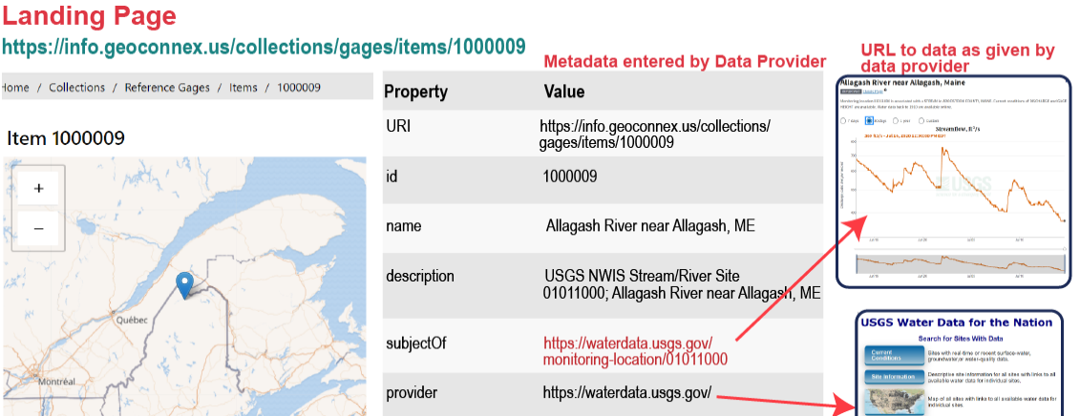
Geoconnex Does 3 Things
(2) Locates Data – provides a stable landing page and redirects users to where data are currently hosted
sdfsfsdfs
(1) Unique IDs – a persistent identifier unique to each dataset
Notes:
(2) Provides a persistent location or landing page for the data. This landing page can be set up to automatically redirect users to where the data are hosted. So if a user searches for this stream gauge and clicks on the URL link for geoconnex – ideally the link will take the user directly to where the data are located.

Slide 13
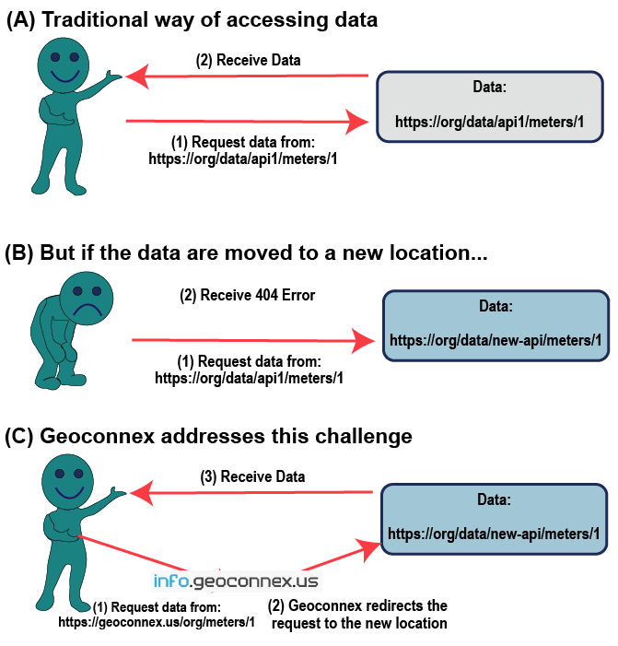
Geoconnex Does 3 Things
sdfsfsdfs
(1) Unique IDs – a persistent identifier unique to each dataset
(2) Locates Data – provides a stable landing page and redirects users to where data are currently hosted
Notes:
This allows software developers and others to use a single URL that won’t change or break even if an agency changes where data are kept. Which will be really important

Slide 14
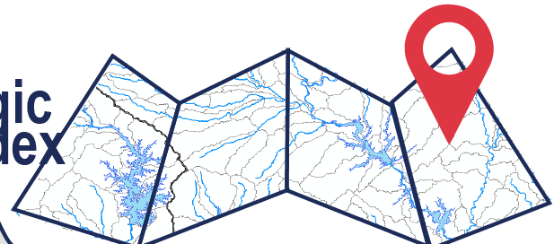
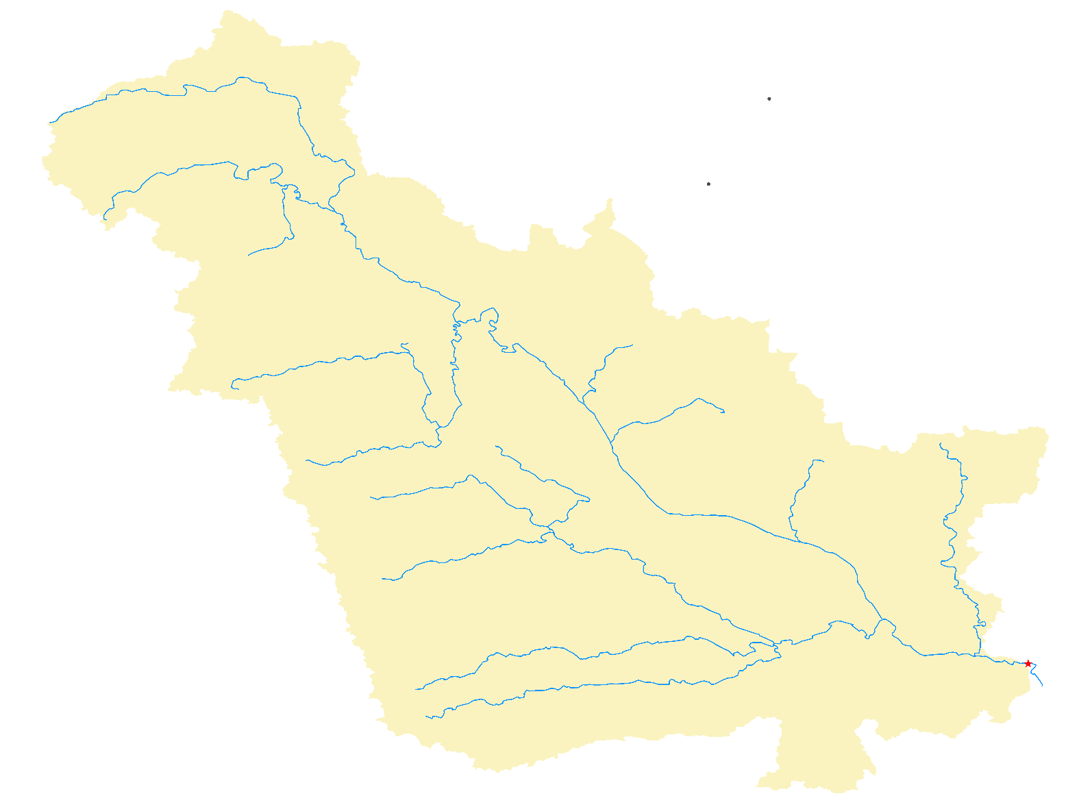
Geoconnex Does 3 Things
sdfsfsdfs
(1) Unique IDs – a persistent identifier unique to each dataset
(2) Locates Data – provides a stable landing page and redirects users to where data are currently hosted
(3) Links Data – enables data to be linked together based on geography and key words
This monitoring station is located inside this watershed
Notes:
Containers

Slide 15
Geoconnex Does 3 Things
sdfsfsdfs
(1) Unique IDs – a persistent identifier unique to each dataset
(2) Locates Data – provides a stable landing page and redirects users to where data are currently hosted
(3) Links Data – enables data to be linked together based on geography and key words
This monitoring station is located inside this watershed
And so are all of
these sites…
Notes:
Containers are data within an area? Does an area contain data?

Slide 16
Geoconnex Does 3 Things
sdfsfsdfs
(1) Unique IDs – a persistent identifier unique to each dataset
(2) Locates Data – provides a stable landing page and redirects users to where data are currently hosted
(3) Links Data – enables data to be linked together based on geography and key words
Are data located WITHIN a watershed (aquifer, city, county, service area…)?
Does a watershed CONTAIN a stream gauge, well, water intake, etc.
Notes:
Containers are data within an area? Does an area contain data?

Slide 17
Finding Linked Data
sdfsfsdfs
Locations (e.g. stream gages, wells,
dam locations)
Features of Interest (e.g. public water
systems, lakes)
Cataloging Features (e.g. HUC boundaries, administrative boundaries)
The metadata contains information about how data intersects a container
(“cataloging features”)
selfie:within/contains
Notes:
We’ve conceptualized two groups of water data resources that might exist on the internet. On the left is a group of “Community Reference Features”. These are common locations, features of interest, or broad contextual areas where many organizations might be publishing data about or within. On the right is a typical organizational website about a particular place they provide data about.

Slide 18
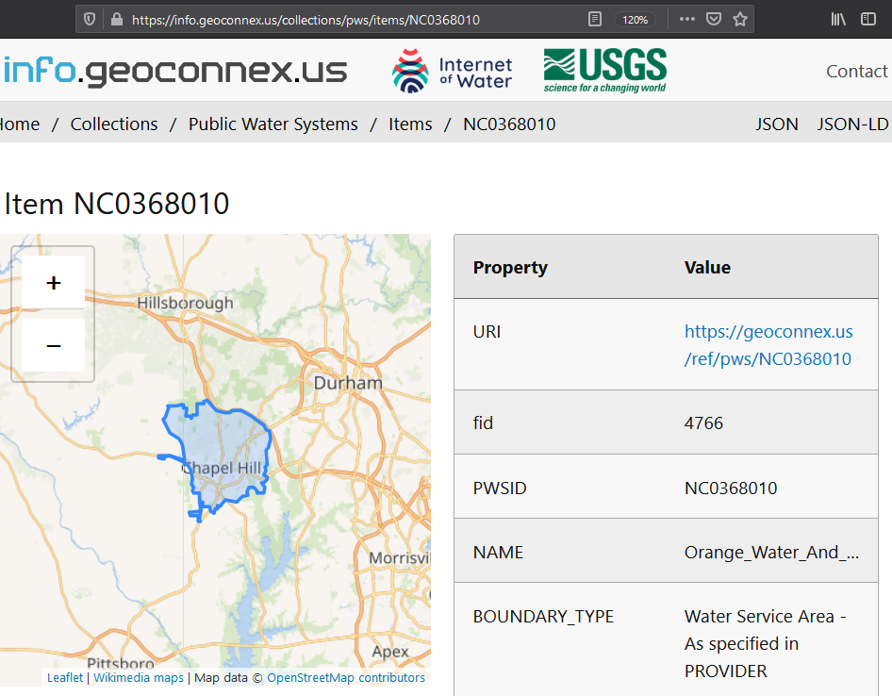
Finding Linked Data
sdfsfsdfs
Locations (e.g. stream gages, wells, dam locations)
Features of Interest (e.g. public water systems, lakes)
Cataloging Features (e.g. HUC boundaries, admin boundaries)
Notes:
Or let’s say a state wants to link to different data. For example, public water system boundaries might point an end user to EPA’s safe drinking water data about the system

Slide 19
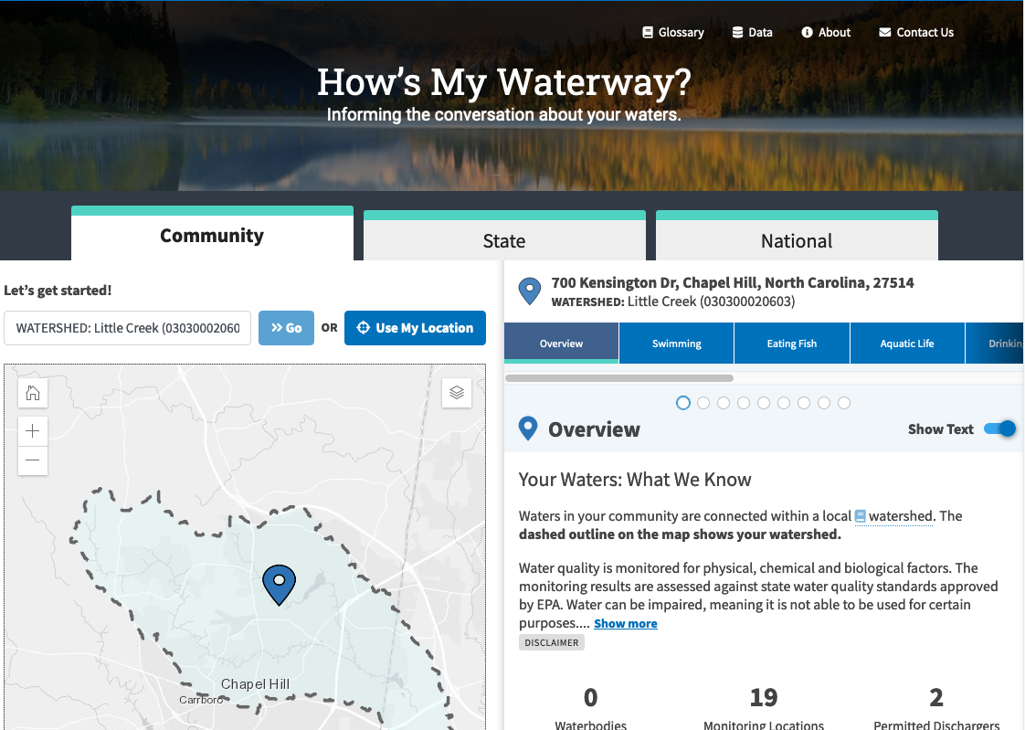
Finding Linked Data
sdfsfsdfs
Locations (e.g. stream gages, wells, dam locations)
Features of Interest (e.g. public water systems, lakes)
Cataloging Features (e.g. HUC boundaries, admin boundaries)
Notes:
Or let’s say a state wants to link to different data. For example, public water system boundaries might point an end user to EPA’s safe drinking water data about the system

Slide 20
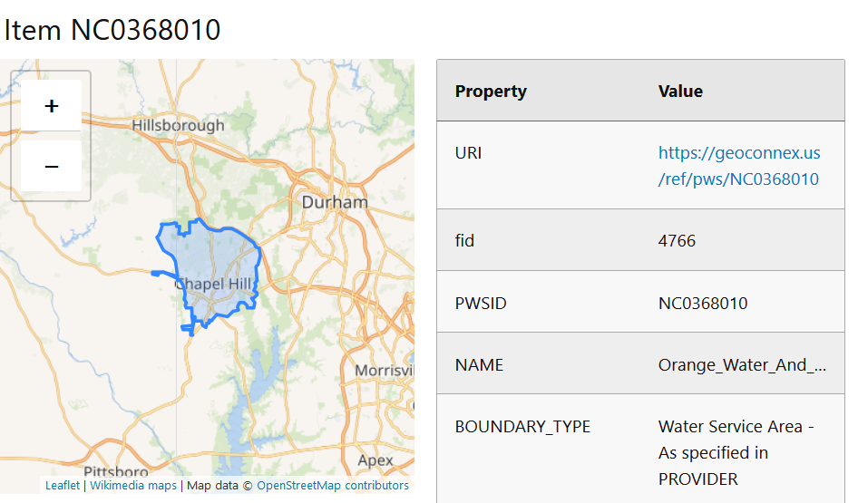
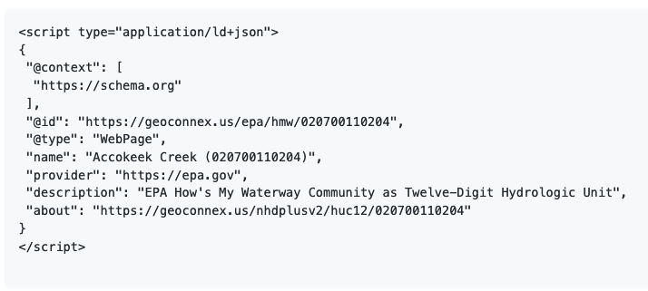
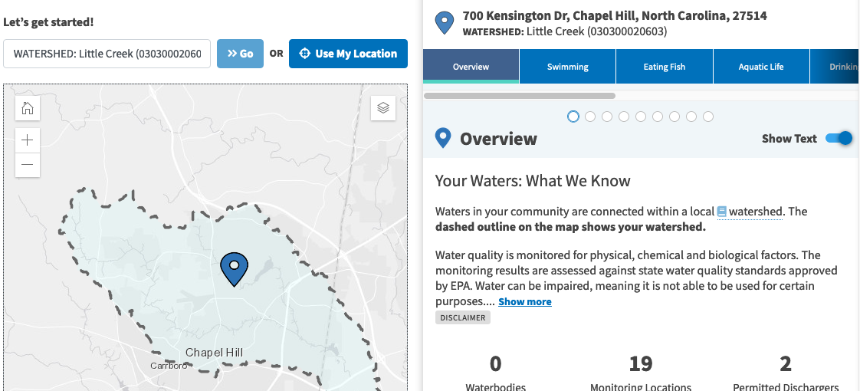
Persistent Id
Embedded Link to a Watershed
HUC 12
Notes:
Within the epa page – you can see they identify that this public water service boundary is located within a specific watershed (HUC12). Any data they have that are linked to a specific website can then be pulled as well.
Similar to when you search for Kevin Bacon – you will also find all the movies Kevin Bacon has ever been in…
Embedded within HTML script headers of that page are structured metadata. This is machine-readable data that can be automatically harvested by web crawlers such as Google. Project geoconnex envisions organizations populating this structured metadata with links to the community reference feature websites. We are conducting research with the USGS on how exactly to provide guidance about this metadata, and create software tools to generate and validate this metadata easily.
Notice also the PIDs using the “geoconnex.us” based URL. This is why the PIDs are so important. An agency can rest assured these links will never change when they put it in their metadata. All the agency then has to do if they move their website is to change where the landing page will redirect too. We provide this service so that data publishing organizations can change their URL patterns without changing the URLs that data users rely on to build applications.

Slide 21
FUTURE PLANS

Slide 22
“Knowledge Graph”
A search index for water data
Integration with NHD

Slide 23
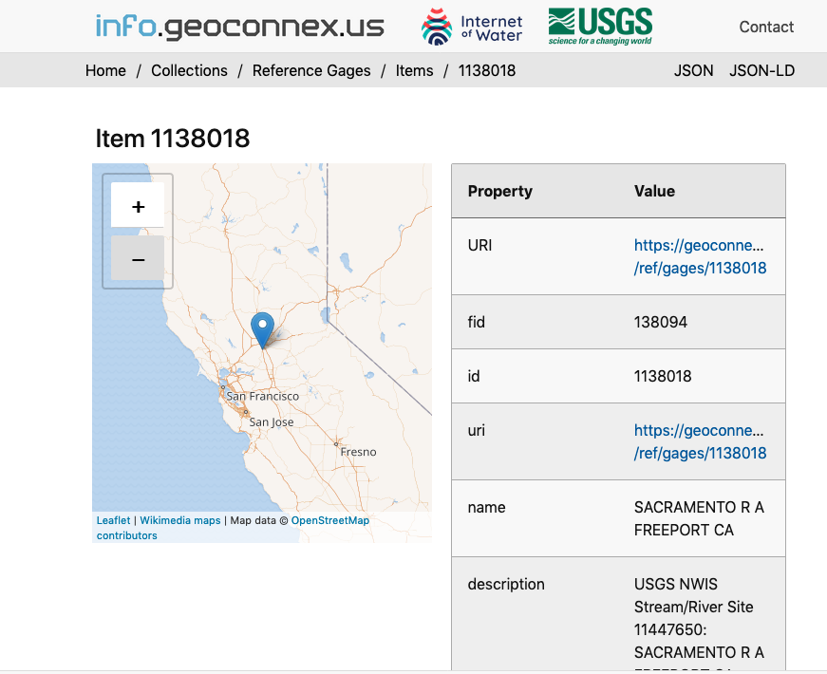
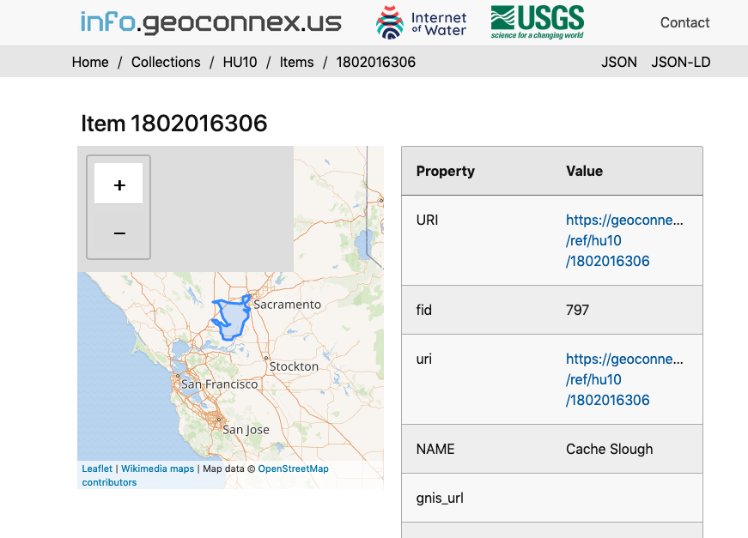
Building a Water Knowledge Graph: Community Reference Features
Reservoir
Bridge monitoring location
Link: within
Link: within
HUC12
https://geoconnex.us/ref/{feature_type}/{feature_id}
Notes:
So, we have this system of linked community reference websites.

Slide 24
Building a Water Knowledge Graph: Organizations publish data
https://geoconnex.us/{org}/{feature}/{data_id}
Reservoir
Bridge monitoring location
Link: within
Link: within
HUC12
https://geoconnex.us/ref/{feature_type}/{feature_id}
Notes:
And we’re now trying to get as much participation as possible from federal, state agencies, utilities, the private sector, and NGOs to also mint geoconnex identifiers for their data.

Slide 25
Building a Water Knowledge Graph: Organizations Link Data
https://geoconnex.us/{org}/{feature}/{data_id}
Reservoir
Bridge monitoring location
Link: within
Link: within
HUC12
https://geoconnex.us/ref/{feature_type}/{feature_id}
Notes:
And add links to the community reference features that say these data are located within this geography.

Slide 26
Building a Water Knowledge Graph: Crawl
https://geoconnex.us/{org}/{feature}/{data_id}
Web crawler
Reservoir
Bridge monitoring location
Link: within
Link: within
HUC12
https://geoconnex.us/ref/{feature_type}/{feature_id}
Notes:
Then, we will build a water-data specific web-crawler

Slide 27
Building a Water Knowledge Graph: Crawl
https://geoconnex.us/{org}/{feature}/{data_id}
Web crawler
Goes to any site with a geoconnex PID
Reservoir
Bridge monitoring location
Link: within
Link: within
HUC12
https://geoconnex.us/ref/{feature_type}/{feature_id}
Notes:
That will go to every website that has geoconnex identifier (PID)

Slide 28
Building a Water Knowledge Graph: Crawl
https://geoconnex.us/{org}/{feature}/{data_id}
Web crawler
Reservoir
Bridge monitoring location
Harvests links
Link: within
Link: within
HUC12
https://geoconnex.us/ref/{feature_type}/{feature_id}
Notes:
And harverst the links in that page.

Slide 29
Building a Water Knowledge Graph: Crawl
https://geoconnex.us/{org}/{feature}/{data_id}
Web crawler
Reservoir
Bridge monitoring location
Harvests links
Link: within
Link: within
HUC12
https://geoconnex.us/ref/{feature_type}/{feature_id}
Notes:
And harverst the links in that page.

Slide 30
Building a Water Knowledge Graph: Crawl
https://geoconnex.us/{org}/{feature}/{data_id}
Web crawler
Reservoir
Bridge monitoring location
Harvests links
Link: within
Link: within
HUC12
https://geoconnex.us/ref/{feature_type}/{feature_id}
Notes:
And harverst the links in that page.

Slide 31
Search and Browse the Graph!
Find all relevant (participating) water data
User Interface
Search by:
Organization
Parameter
Site name
Site type
Location (lat/lon)
Watershed
State/county/place
Upstream/downstream
And more!
Search
Database
Notes:
From those links we will create a database and a user interface that would allow anyone to search by any number of interesting parameters and be returned a list of all websites from (participating) organizations with relevant water data.

Slide 32
Integrating with NHD
USGS is developing the Hydro-Network-Linked Data Index
https://waterdata.usgs.gov/blog/nldi-intro
An open-source, publicly accessible system to index any geospatially-referenced data to NHDPlus catchments and reach codes
Enable hydrologically-relevant search (e.g. upstream/downstream)
Notes:
And harverst the links in that page.

Slide 33
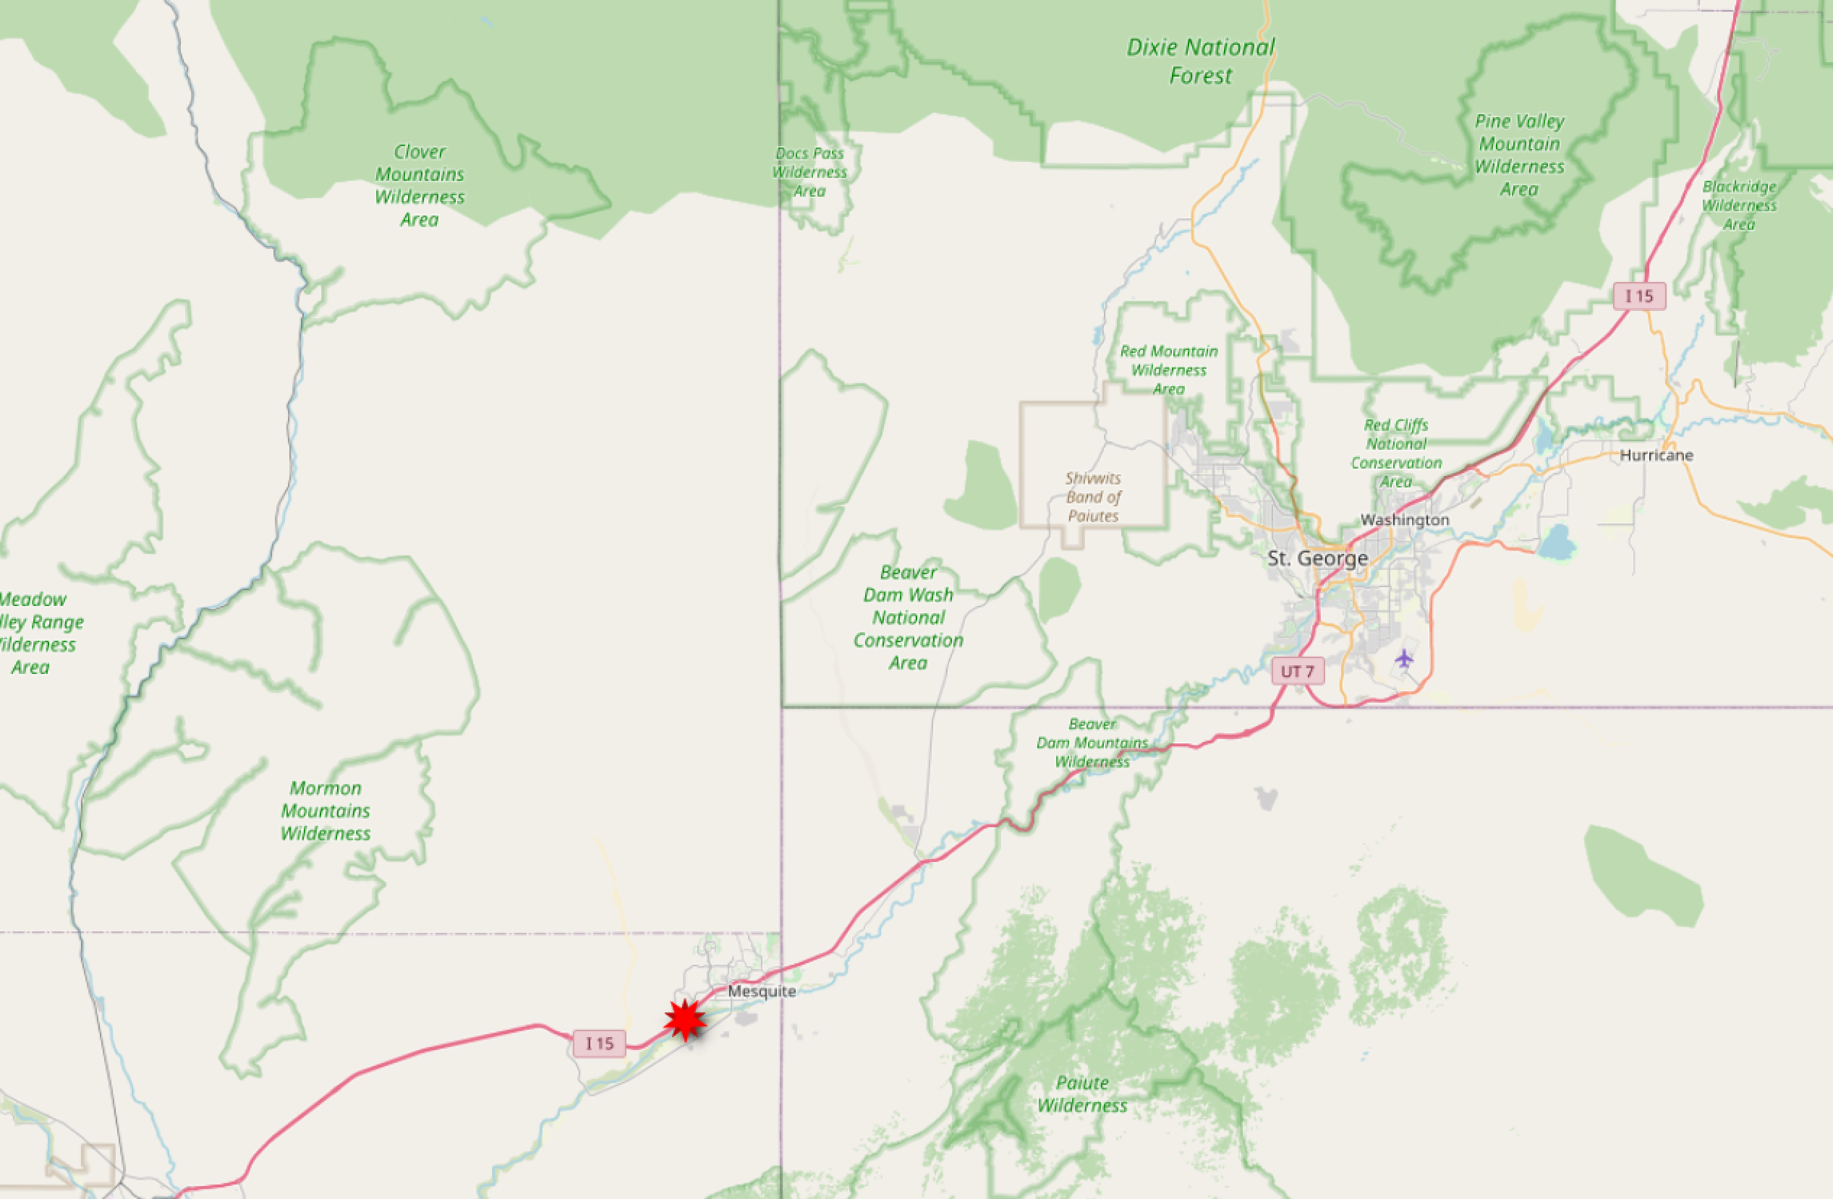
Integrating with NHD
https://labs.waterdata.usgs.gov/api/nldi/linked-data/nwissite/USGS-364700114080301
Notes:
And harverst the links in that page.

Slide 34
Integrating with NHD
https://labs.waterdata.usgs.gov/api/nldi/linked-data/nwissite/USGS-364700114080301/UM?distance=100
Notes:
And harverst the links in that page.

Slide 35
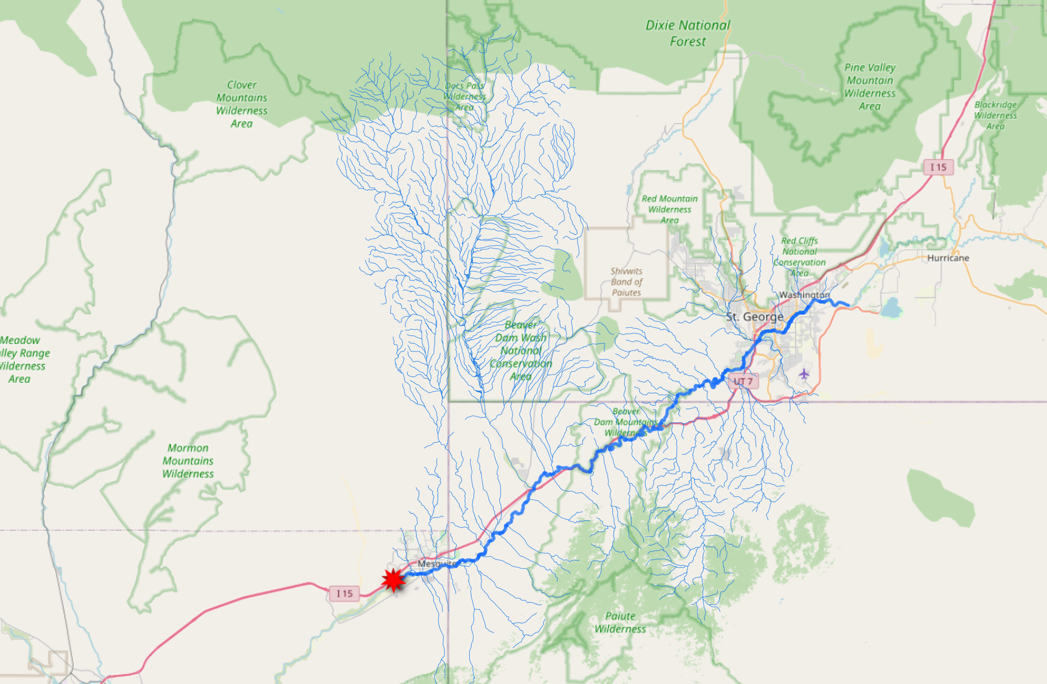
Integrating with NHD
https://labs.waterdata.usgs.gov/api/nldi/linked-data/nwissite/USGS-364700114080301/UT?distance=100
Notes:
And harverst the links in that page.

Slide 36
Integrating with NHD
https://labs.waterdata.usgs.gov/api/nldi/linked-data/nwissite/USGS-364700114080301/UT/nwissite?distance=100
Notes:
And harverst the links in that page.

Slide 37
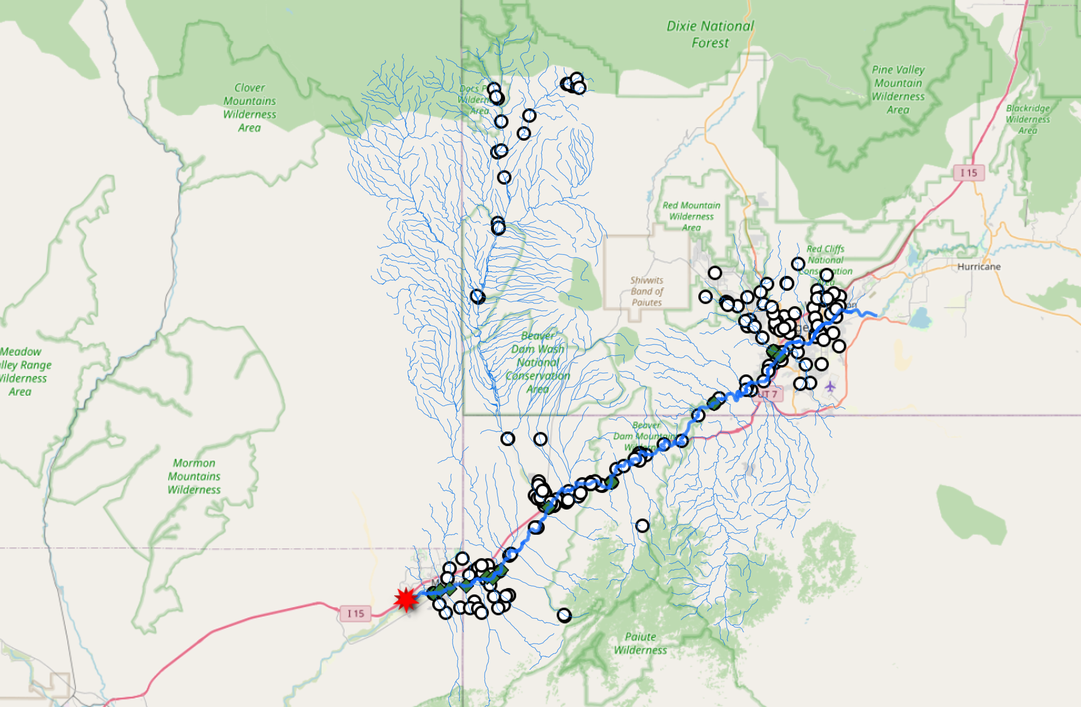
Integrating with NHD
https://labs.waterdata.usgs.gov/api/nldi/linked-data/nwissite/USGS-364700114080301/UT/wqp?distance=100
Notes:
And harverst the links in that page.

Slide 38
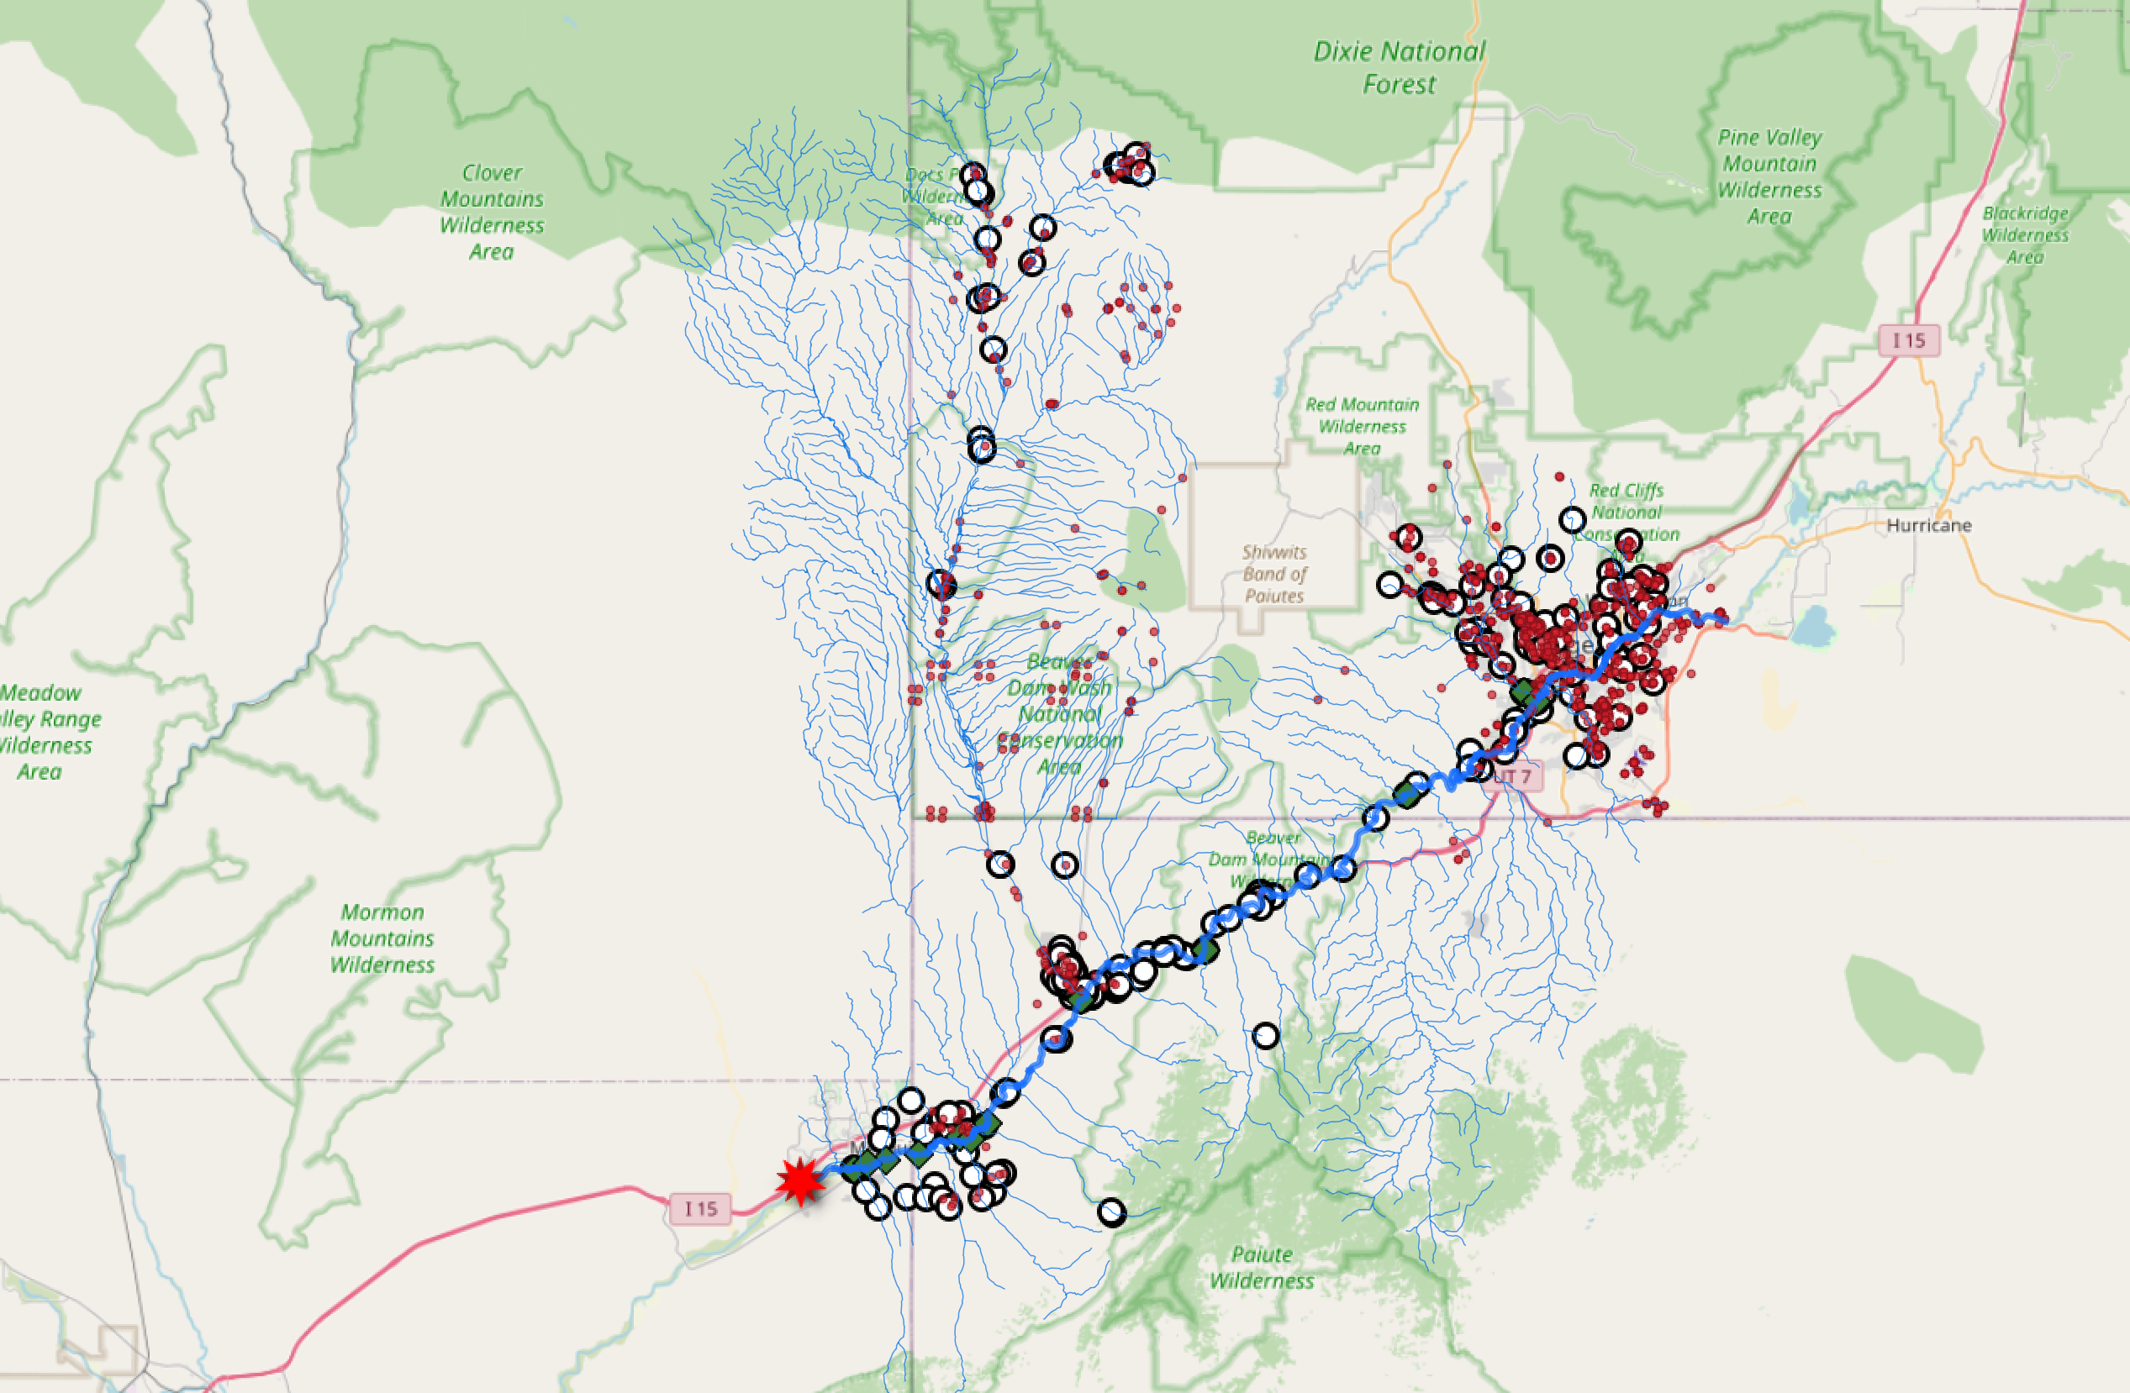
Integrating with NHD
https://labs.waterdata.usgs.gov/api/nldi/linked-data/nwissite/USGS-364700114080301/UT/wade?distance=100
Notes:
And harverst the links in that page.

Slide 39
Integrating with NHD
https://labs.waterdata.usgs.gov/api/nldi/linked-data/nwissite/USGS-364700114080301/UT/nmwdi?distance=100 ????
Notes:
And harverst the links in that page.

Slide 40
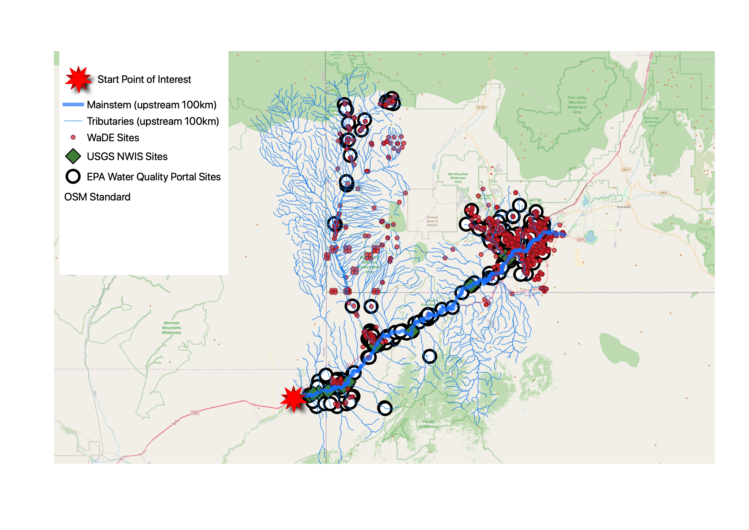
Integrating with NHD
To contribute data:
Need:
1) Locations with lat/lon
2) Location-specific landing pages
3) Persistent identifiers for those landing pages
Notes:
And harverst the links in that page.

Slide 41
Integrating with NHD
To contribute data:
Require:
1) Locations with lat/lon
2) Location-specific landing pages
3) Persistent identifiers for those landing pages
NMWDI representations can be used for this
Notes:
And harverst the links in that page.

Slide 42
In summary:
This use case can be accomplished only if everyone is willing and able to document and add links in their data to data that is not theirs
Are we all willing to care
a little
about how our data relates to others’?
Notes:
To ge there, we need data providers to be willing and able to link their data. Project geoconnex is about providing a structure for this, and hopefully making it as easy as possible

Slide 43
Learn More
Internet of Water : https://internetofwater.org
Project Geoconnex: https://geoconnex.us
Geoconnex reference features: https://info.geoconnex.us
Contact: kyle.onda@duke.edu

